Slide 1

Student Profile Management System
FODS Portfolio
By Divyashi ,Rajan, Krishna and Suraj

Slide 2
Basic Requirements Checklist
Feature | Implemented | Notes
Login System | ✔️ | Validates credentials using passwords.txt
Role Differentiation | ✔️ | Loads appropriate dashboard for Admin or Student
Add/Update/Delete Student Records (Admin) | ✔️ | Managed via users.txt, grades.txt, eca.txt
View/Update Personal Info (Student) | ✔️ | Students can edit their own profile
Data Insights (Admin) | ✔️ | Generates averages, top ECA participants
OOP Concepts | ✔️ | Classes for User, Student, Admin
File Handling | ✔️ | Reads/writes to .txt files for persistence
Exception Handling | ✔️ | Covers file errors, input validation, etc.
Objective: Design and implement a Python-based Student Profile Management System using text files for storage. The system supports both Admin and Student roles, managing personal data, grades, and extracurricular activities.

Slide 3
📂 File Structure
├── user_view.py # Entry point of the program
├── data_loader.py #Takes User data
├── auth.py #handles Login system
├── Analytics_dashboard #Works for Digitil Output
│ # Functions for file read/write
├── data/
│ ├── users.txt # User profiles
│ ├── passwords.txt # Username-password pairs
│ ├── grades.txt # Subject-wise marks
│ └── eca.txt # Extracurricular activity records

Slide 4
🔐 Login System
Prompts for username and password.
Checks against passwords.txt.
On success:
Loads profile from users.txt.
Redirects to either Admin or Student dashboard.
On failure:
Displays error and prompts again.
🧑‍💼 Admin Functionalities
Add New Users: Assigns unique ID, stores info in all relevant files.
Modify/Delete Users: Update/delete user data across all files.
View Data Insights:
Average grades per subject.
Most active students in ECA.
Optional: Pie/bar charts using matplotlib.
🎓 Student Functionalities
Update Profile: Modify personal details in users.txt.
View Grades: Subject-wise marks from grades.txt.
View ECA Participation: Info from eca.txt.

Slide 5
🔧 Technologies Used
Language: Python 3.x
Libraries:
pandas, matplotlib, os , tkinter
Concepts:
OOP, file handling, error handling, modular design
⚠️ Exception Handling
Handles:
FileNotFound errors
Incorrect inputs
Duplicate IDs or usernames
Uses try-except blocks in all file and input-sensitive areas.
Source code :

Slide 6
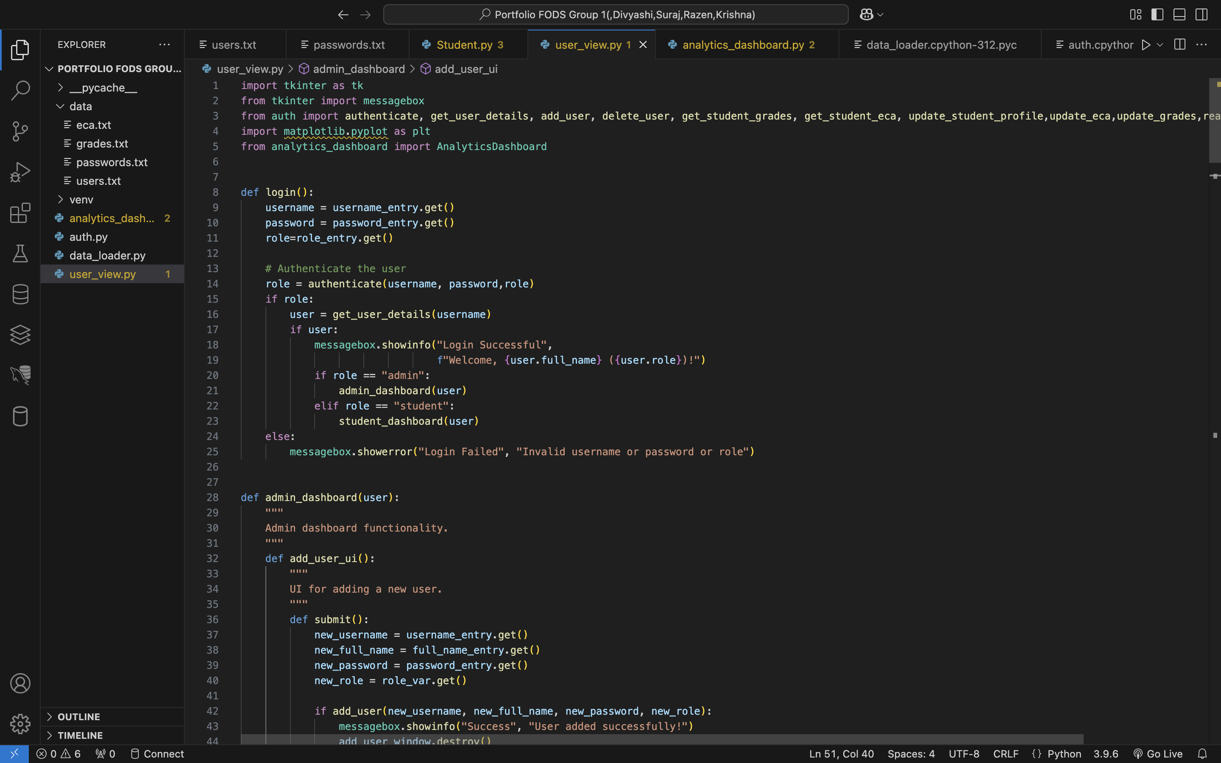
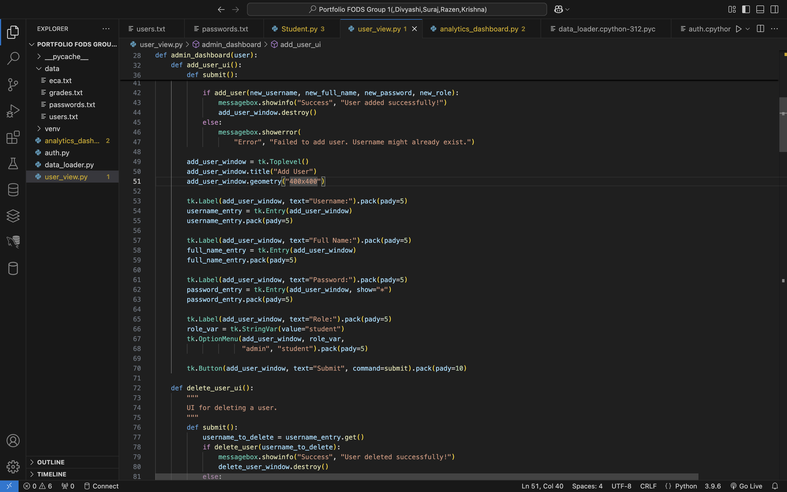

Slide 7
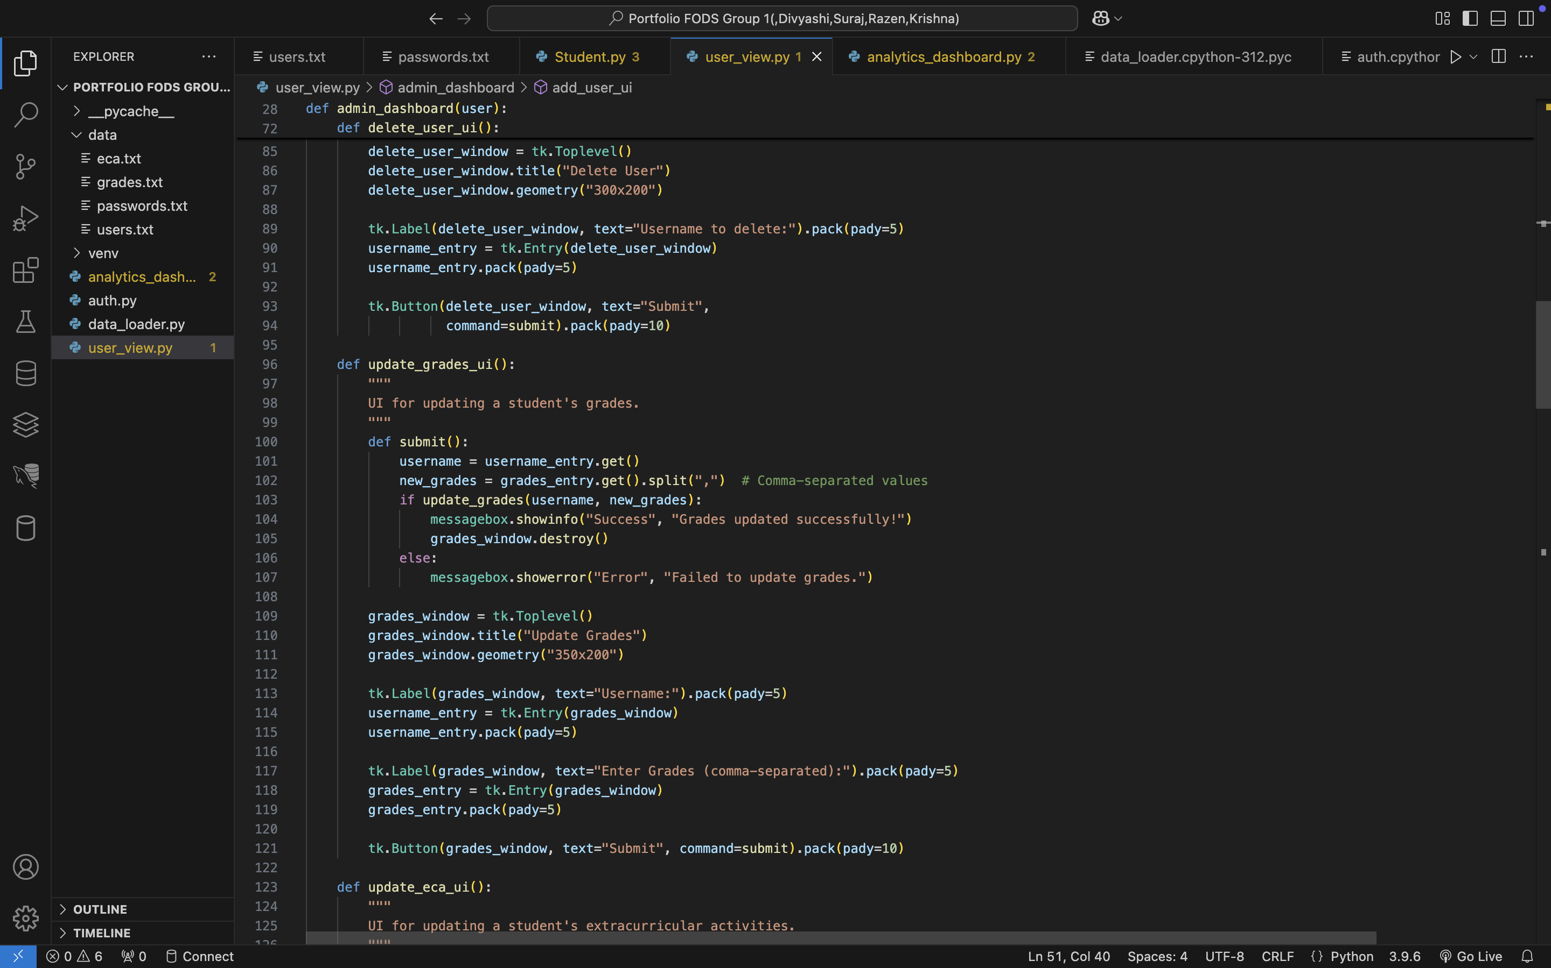
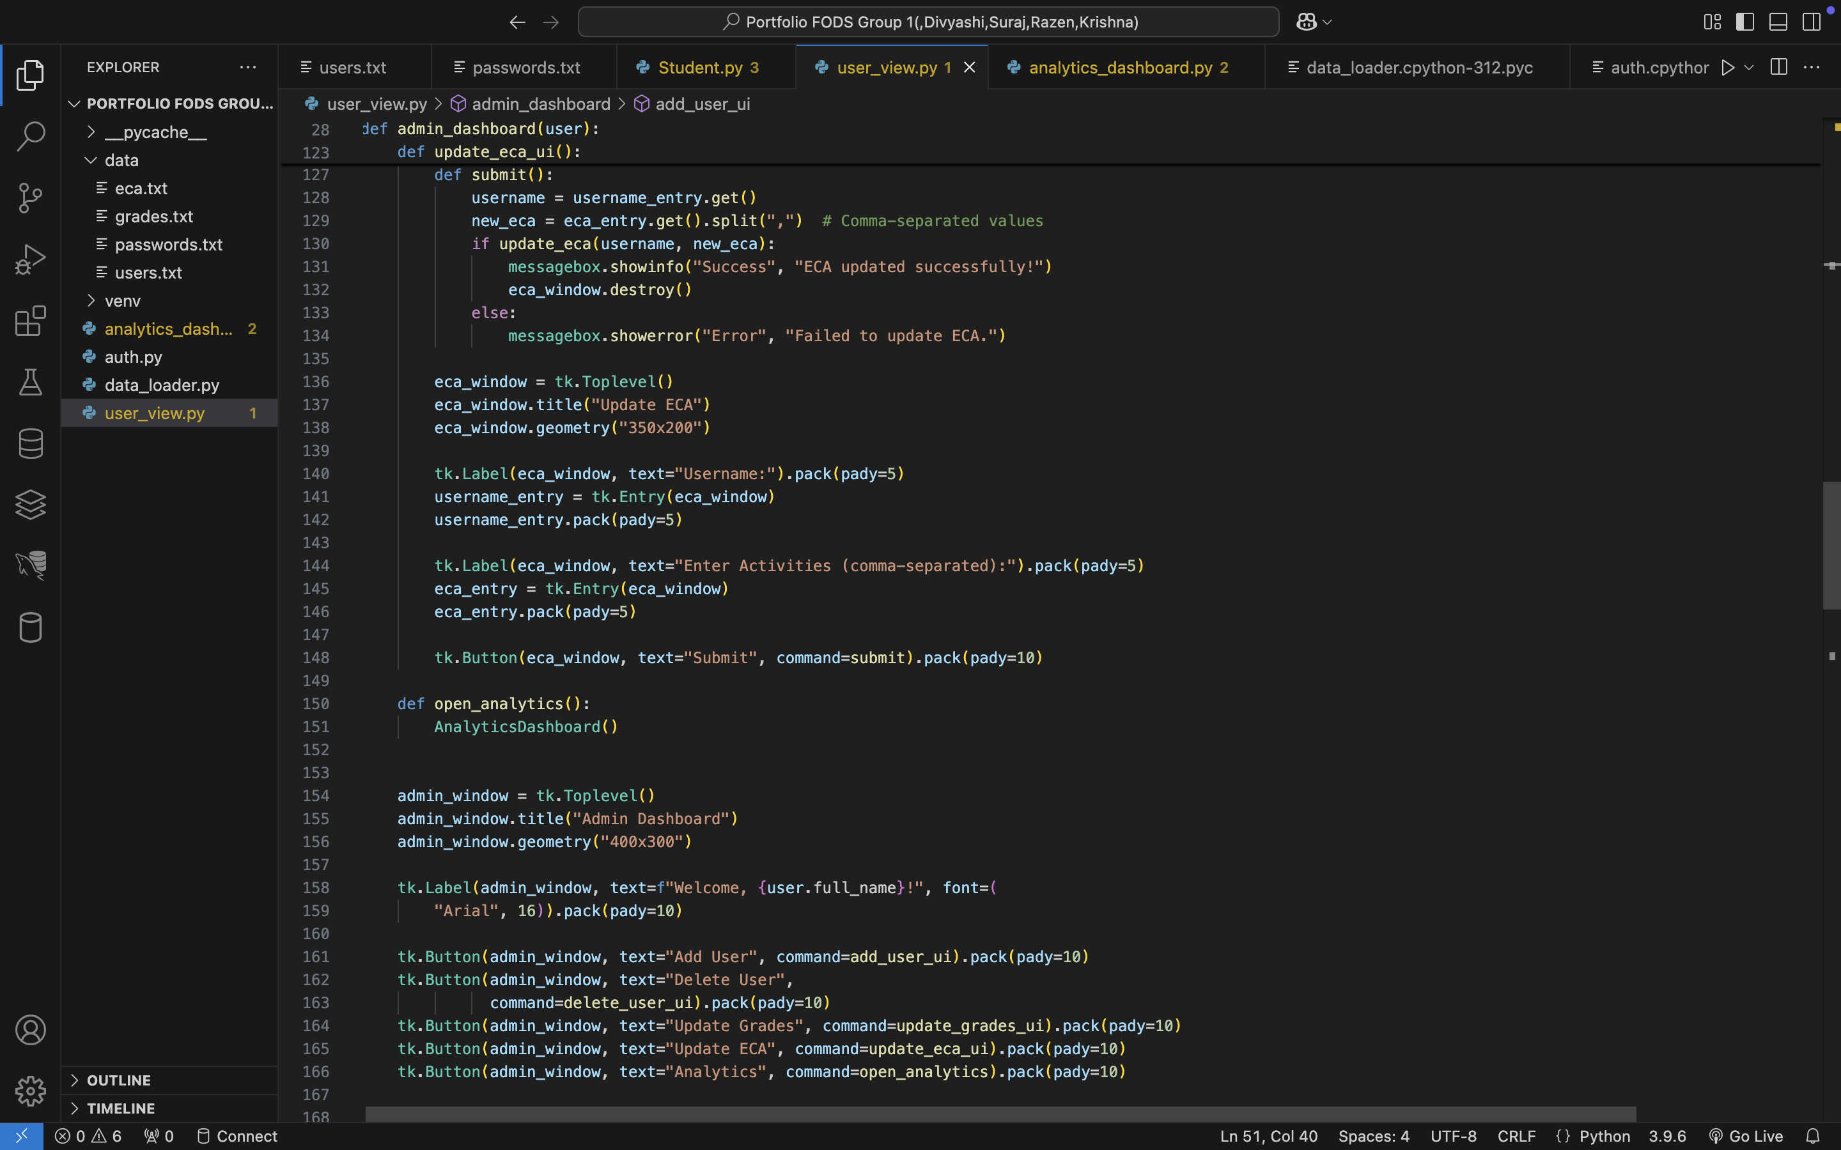

Slide 8
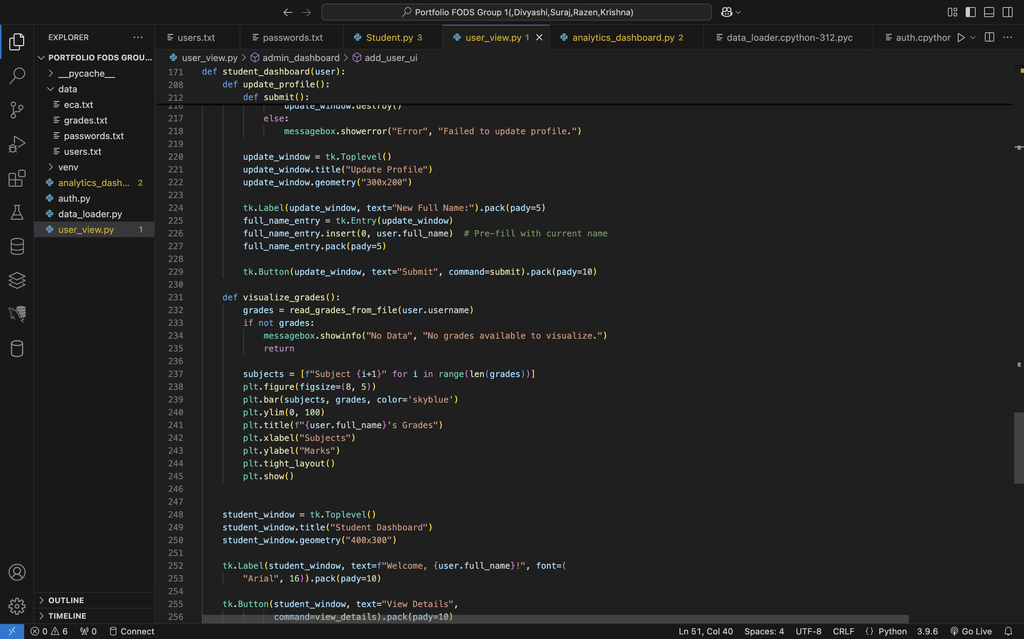
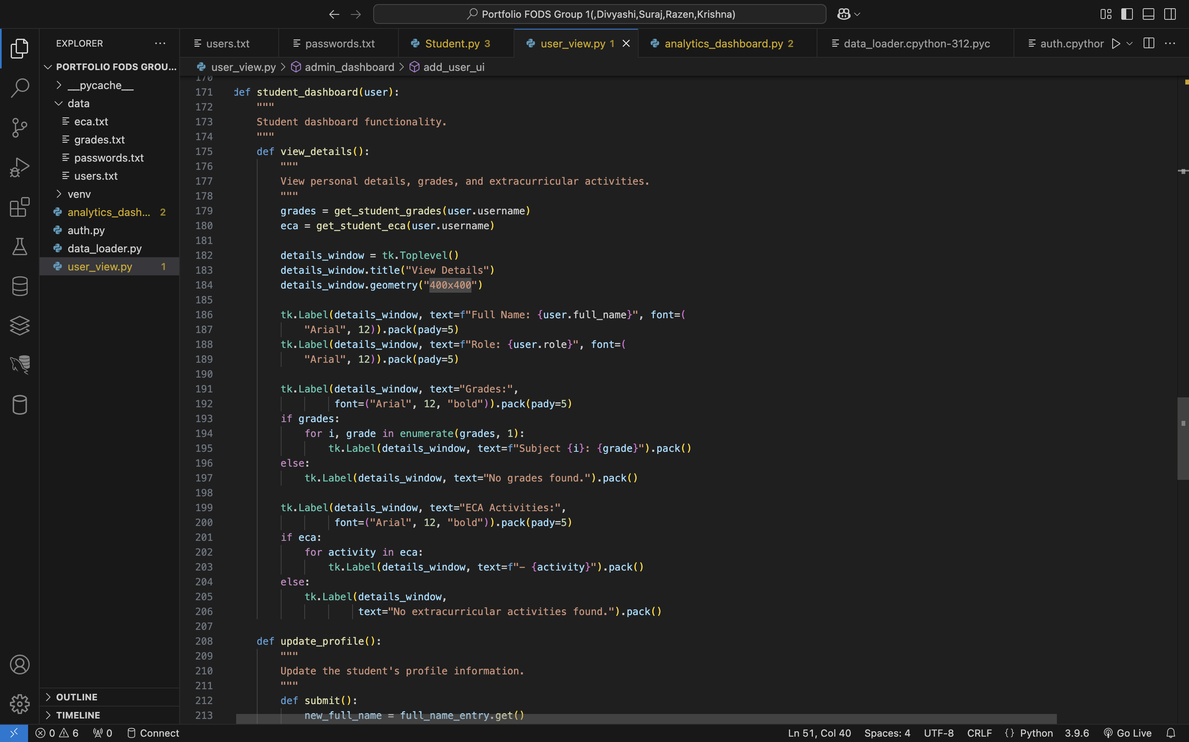

Slide 9
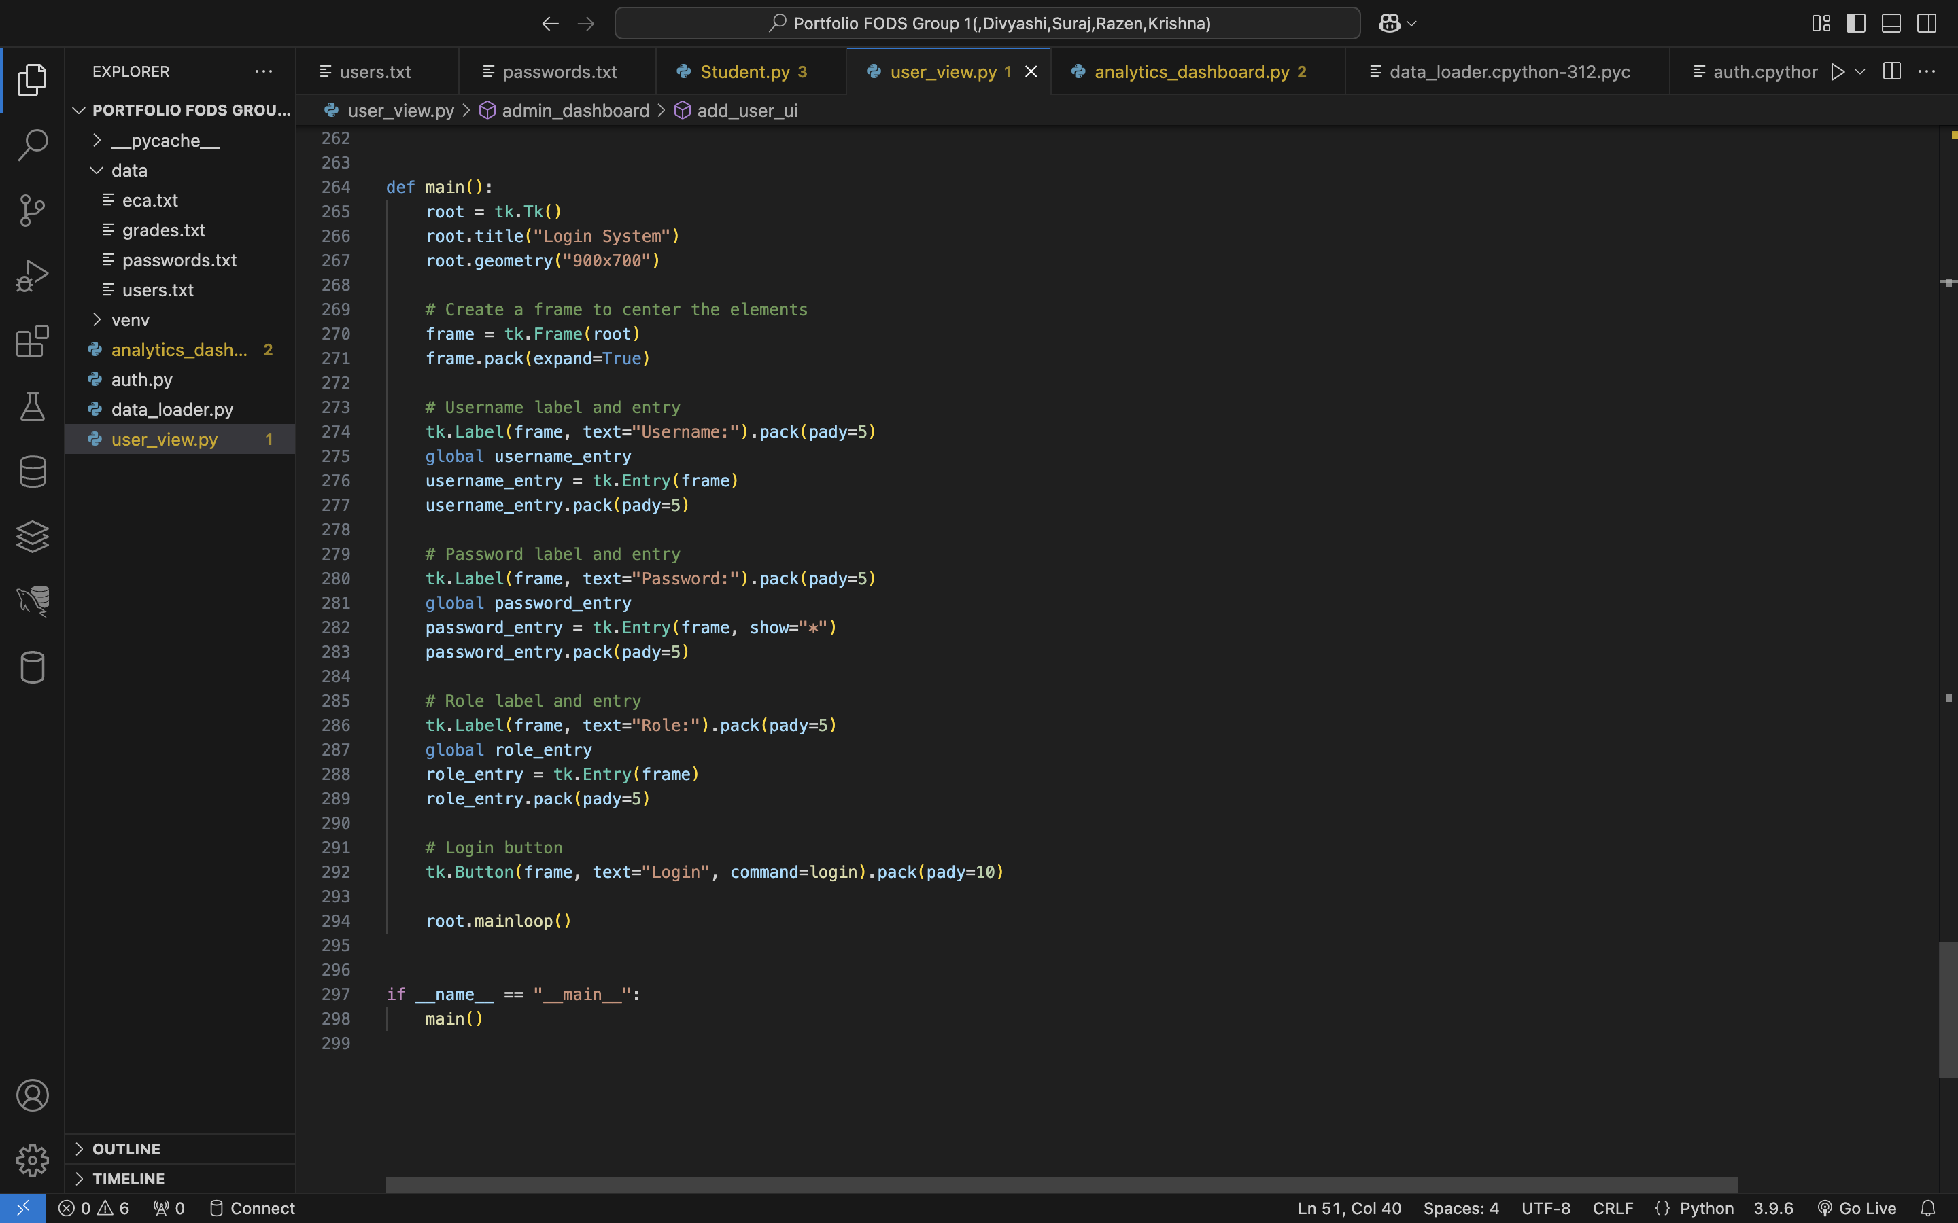
User_view.py upto here

Slide 10
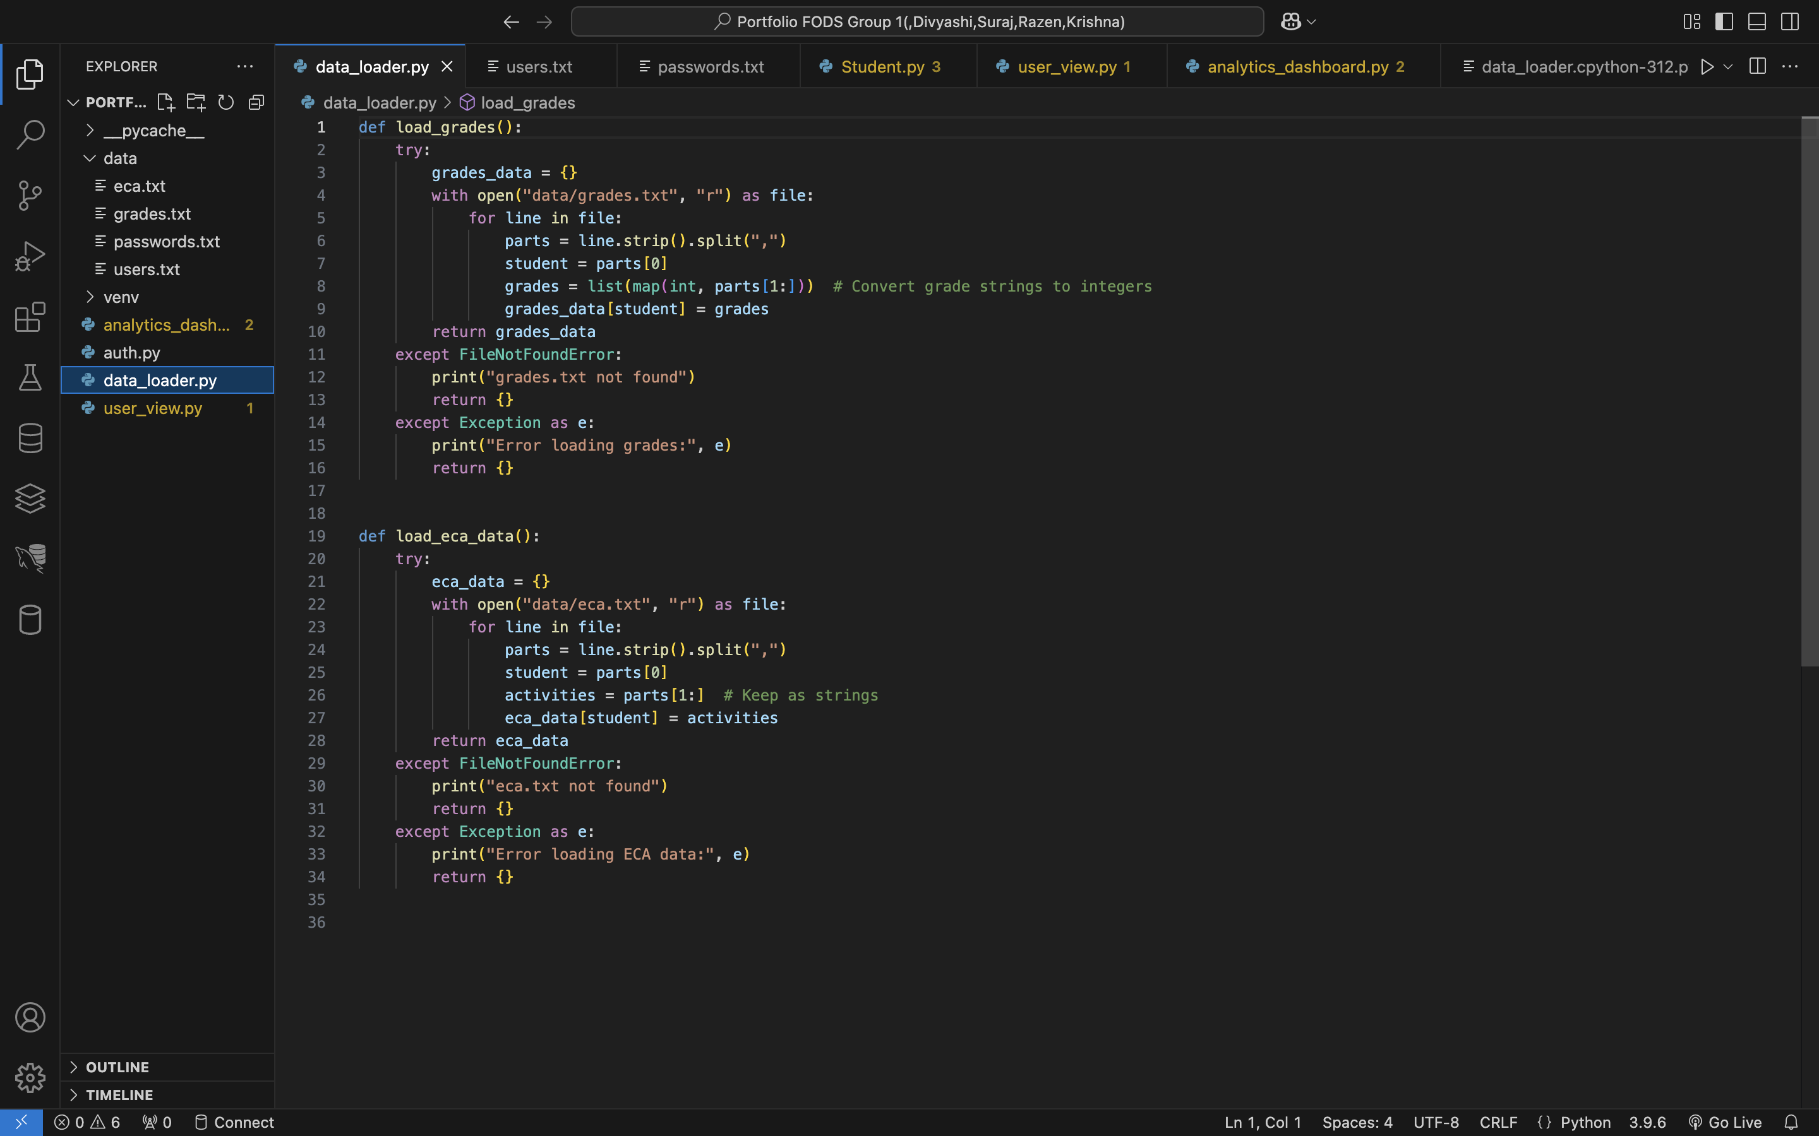
Data_loader.py

Slide 11
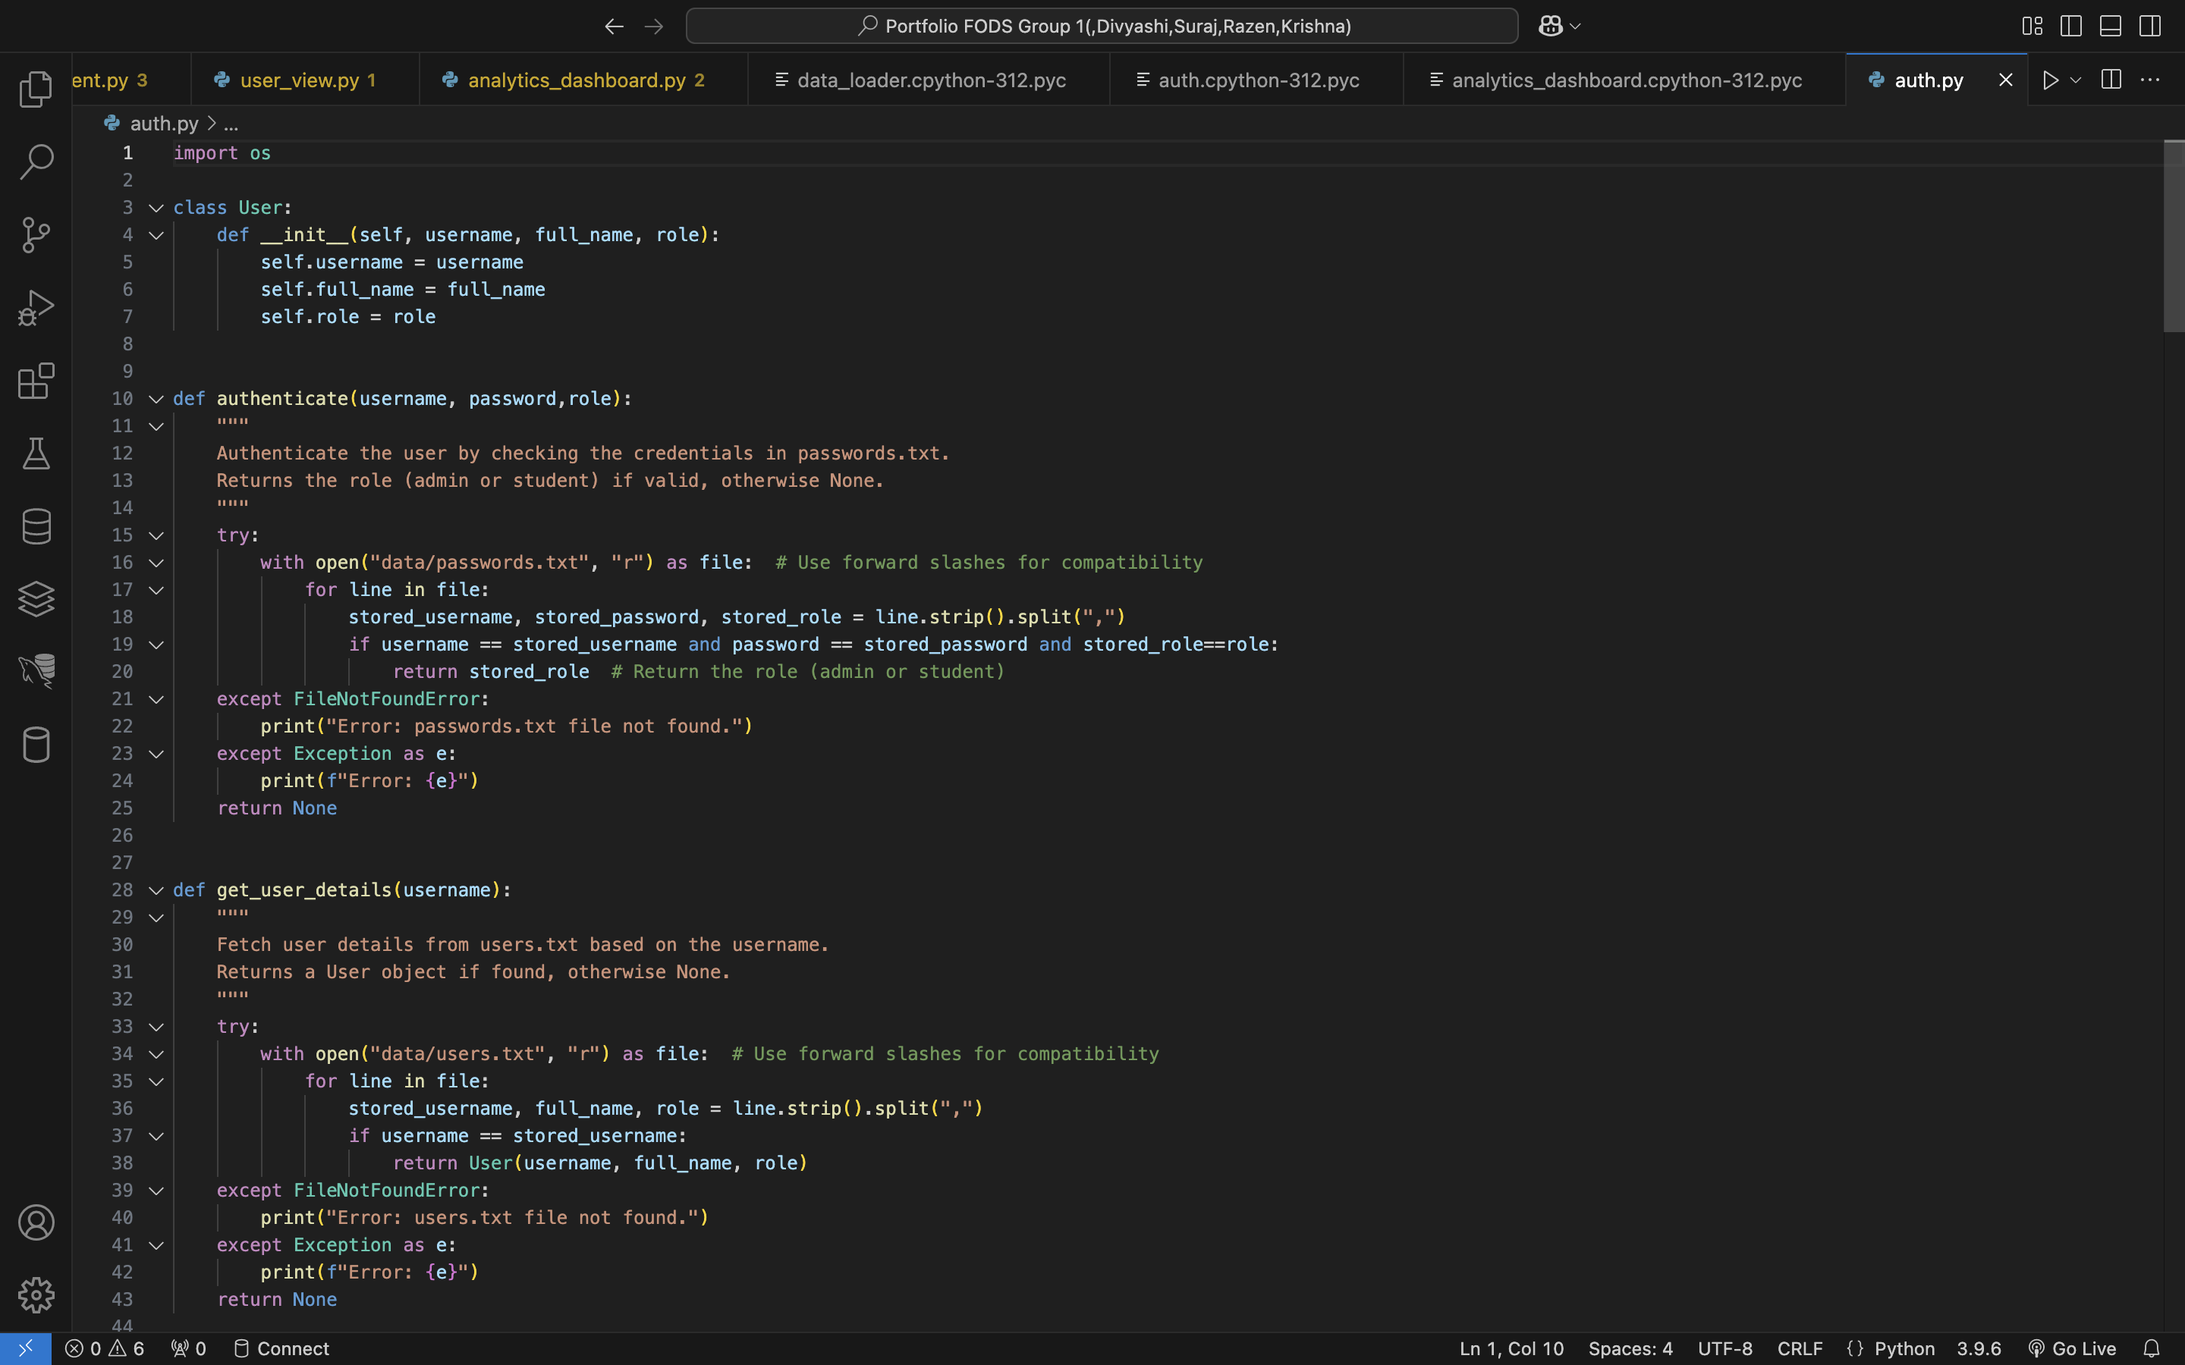
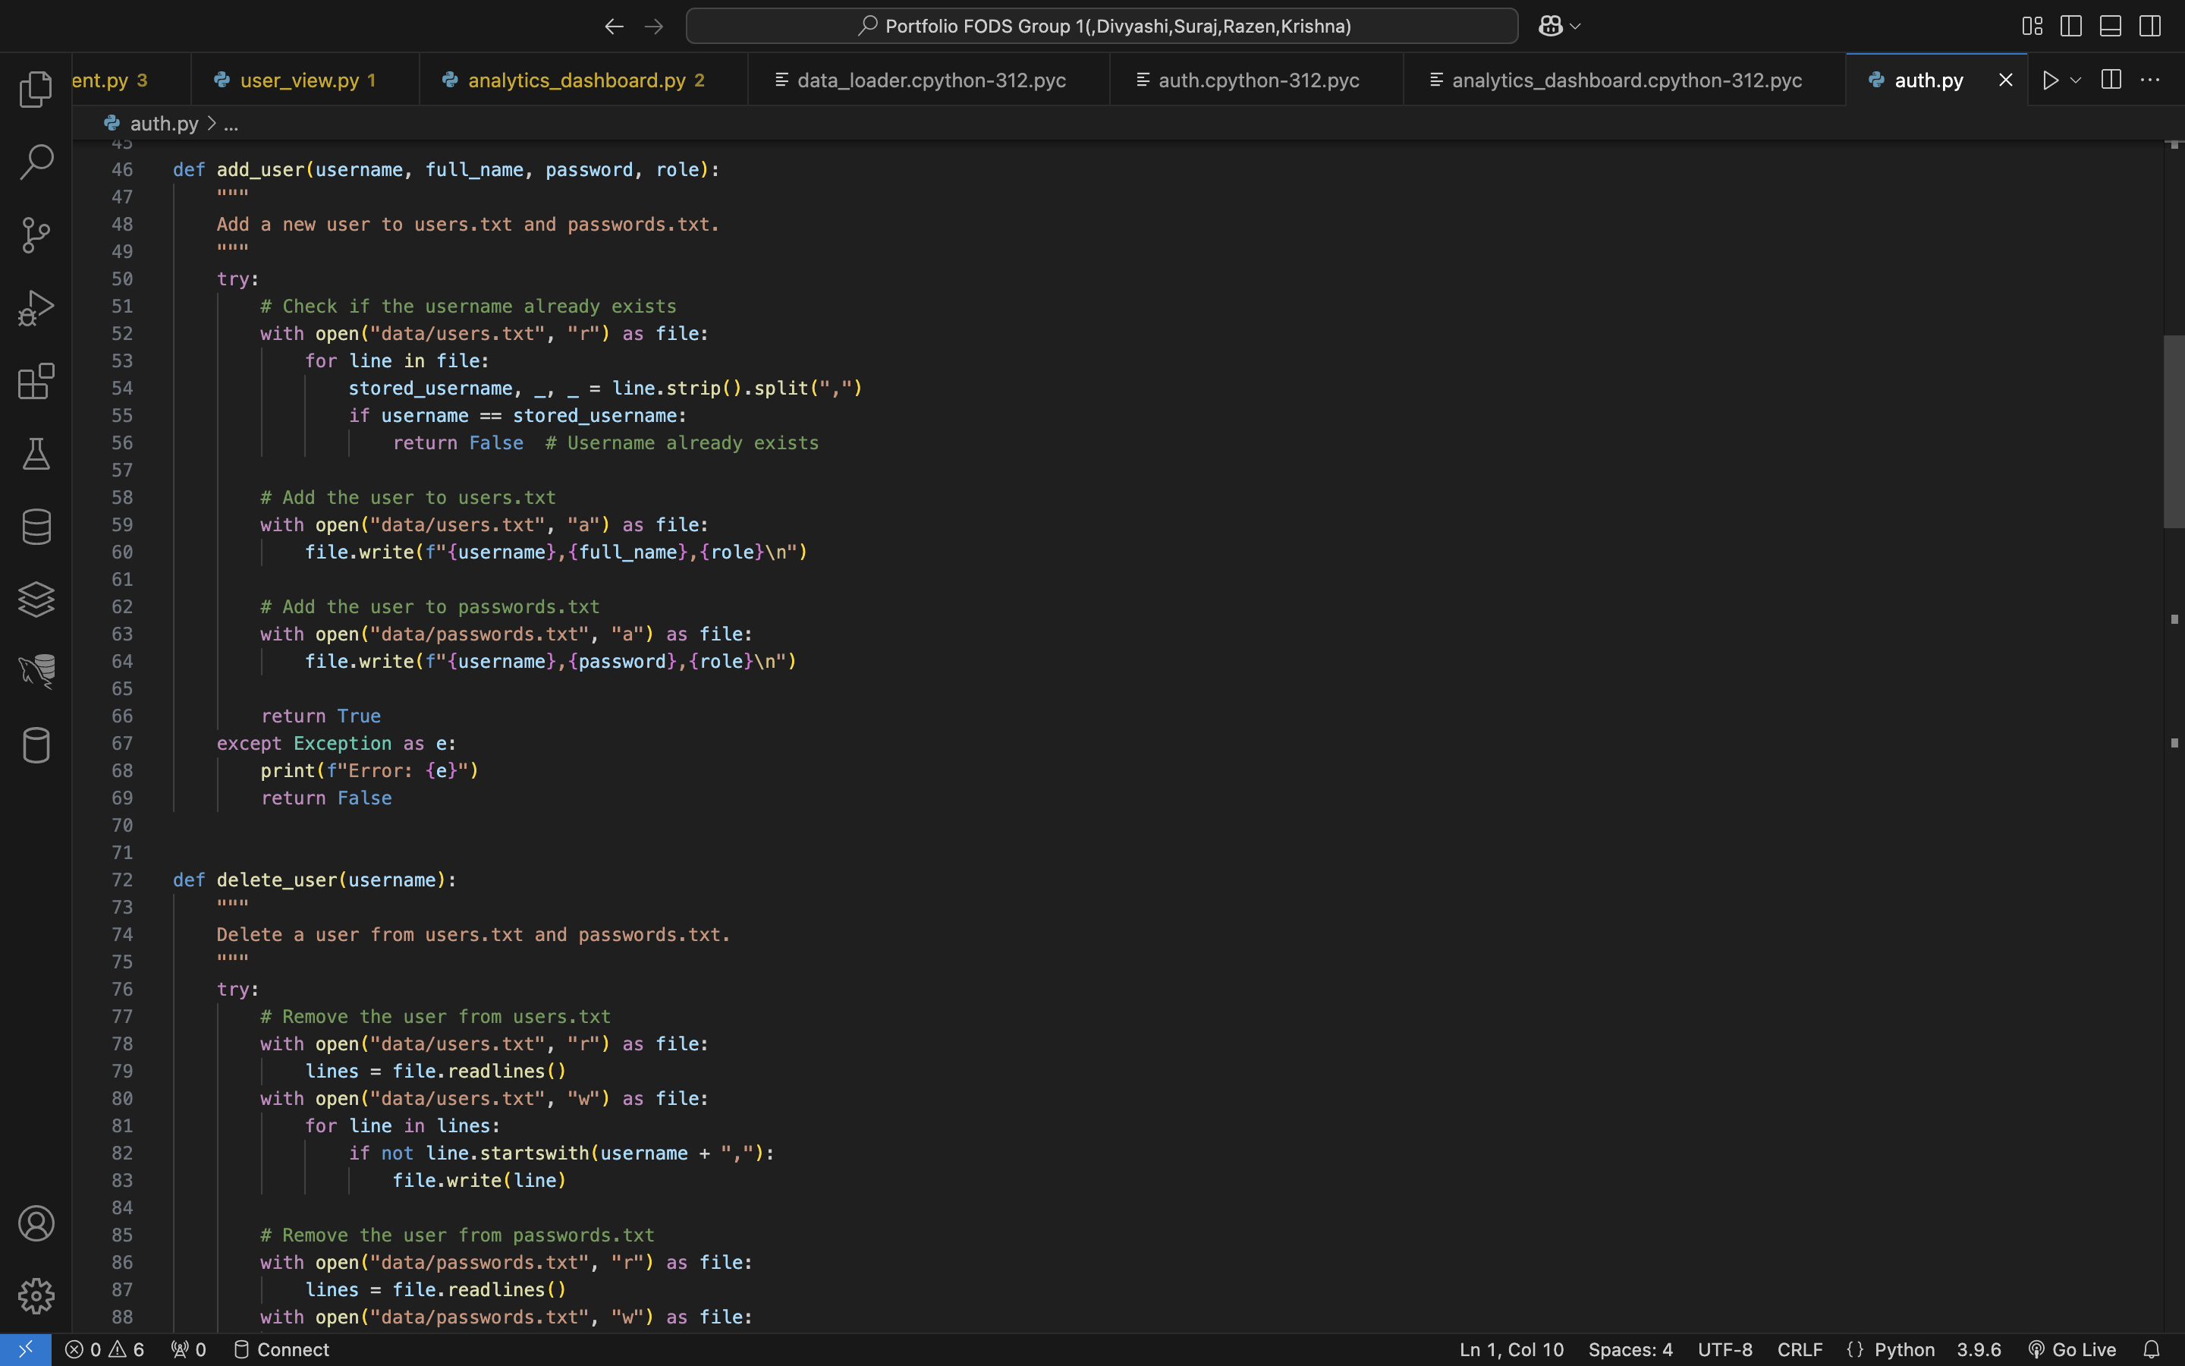

Slide 12
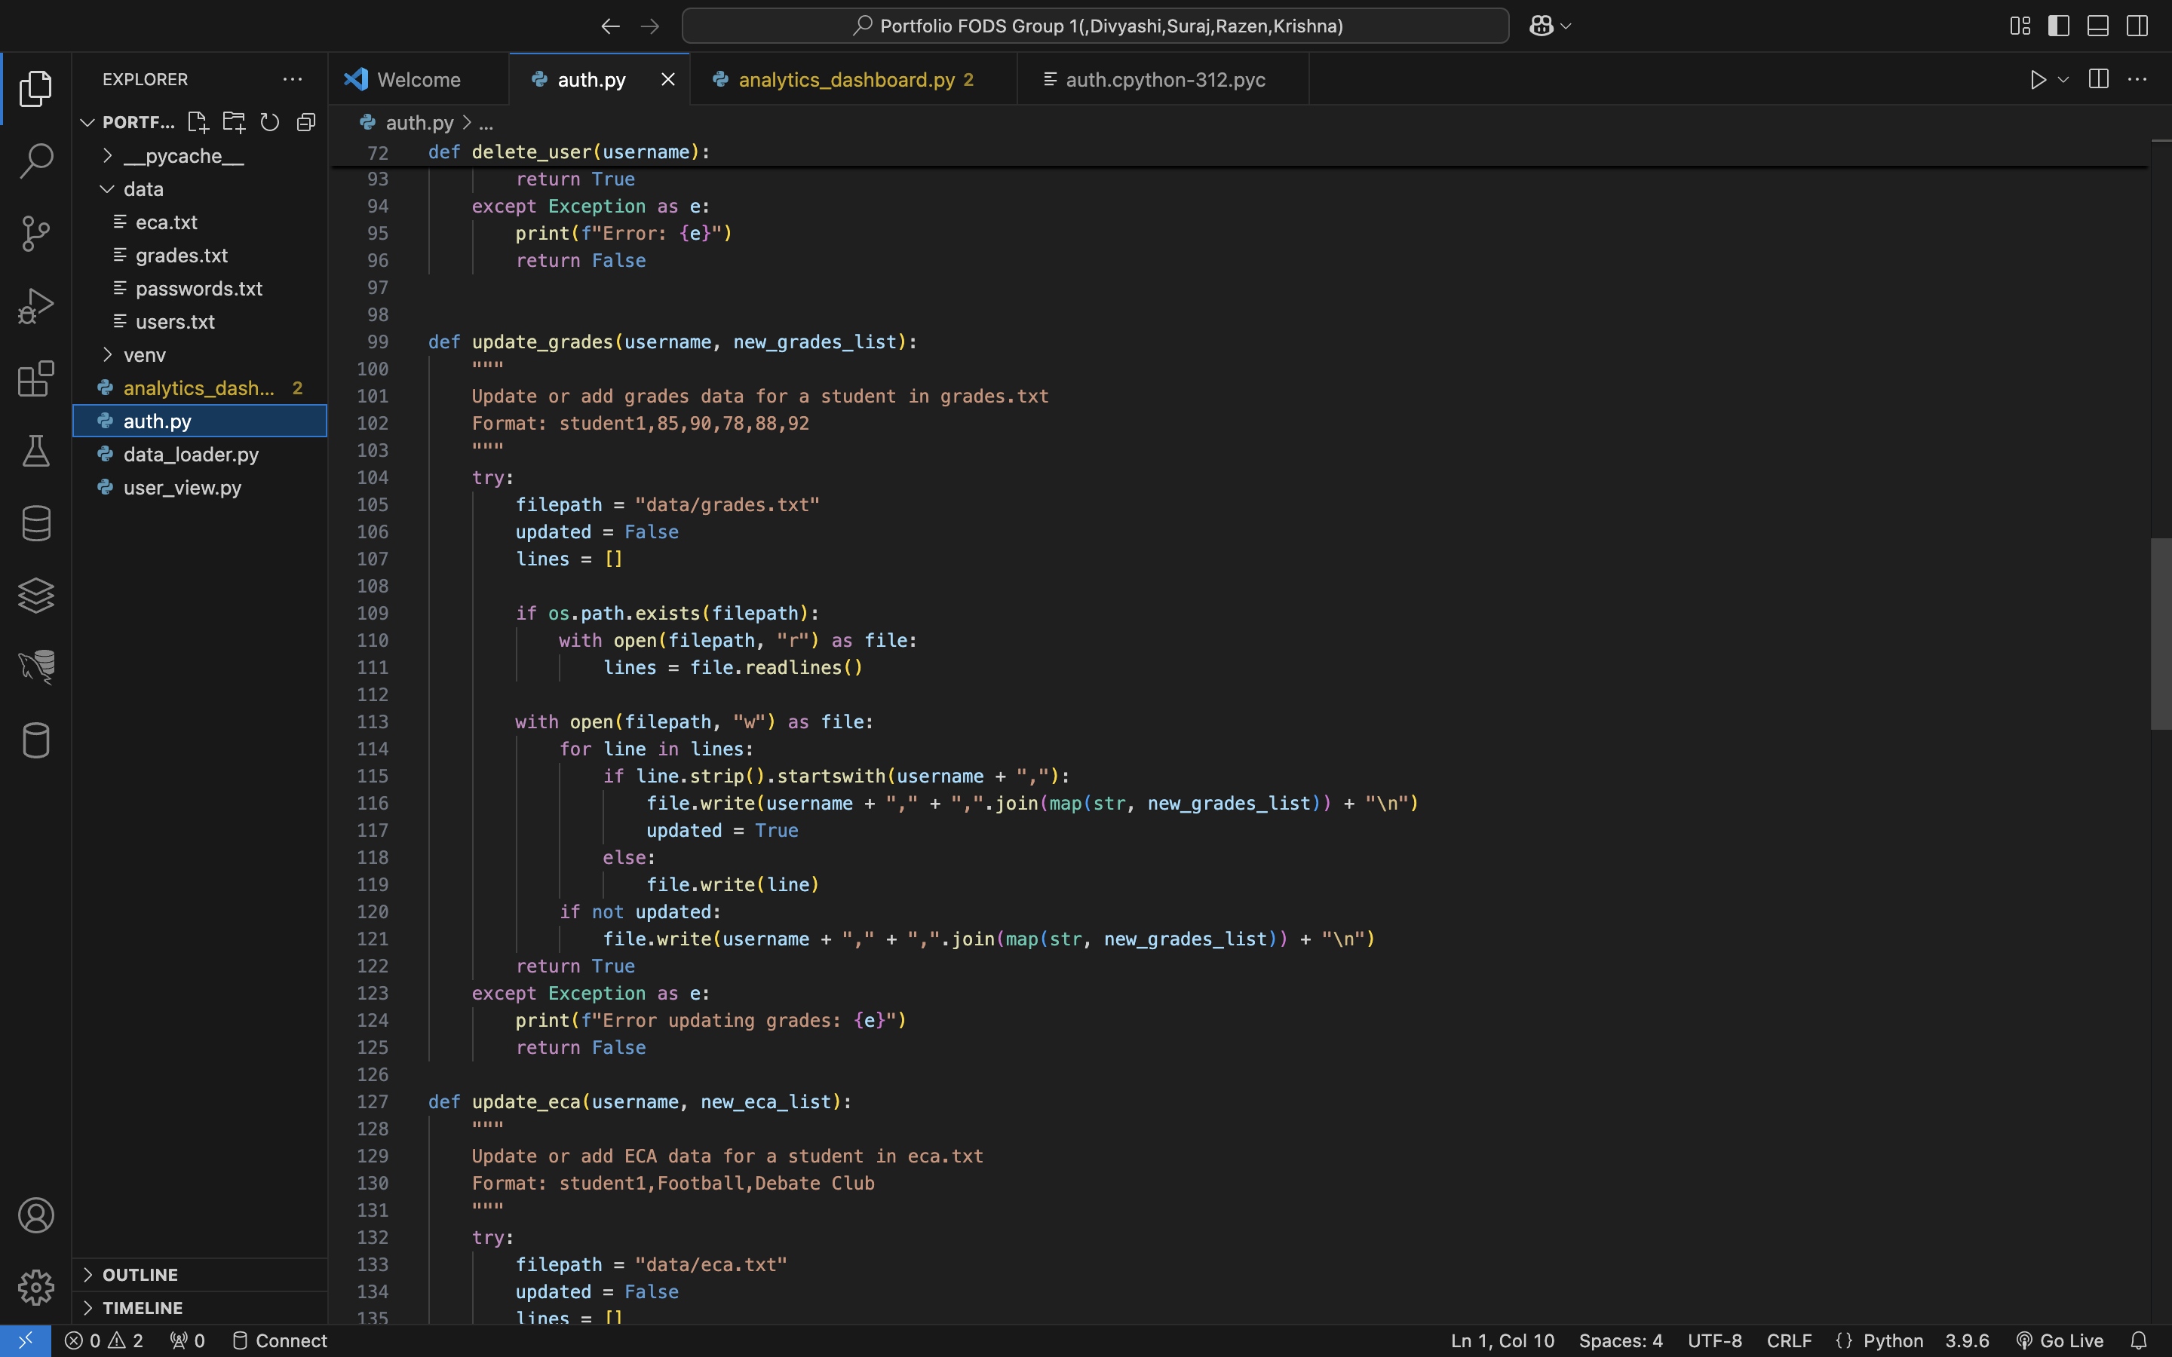
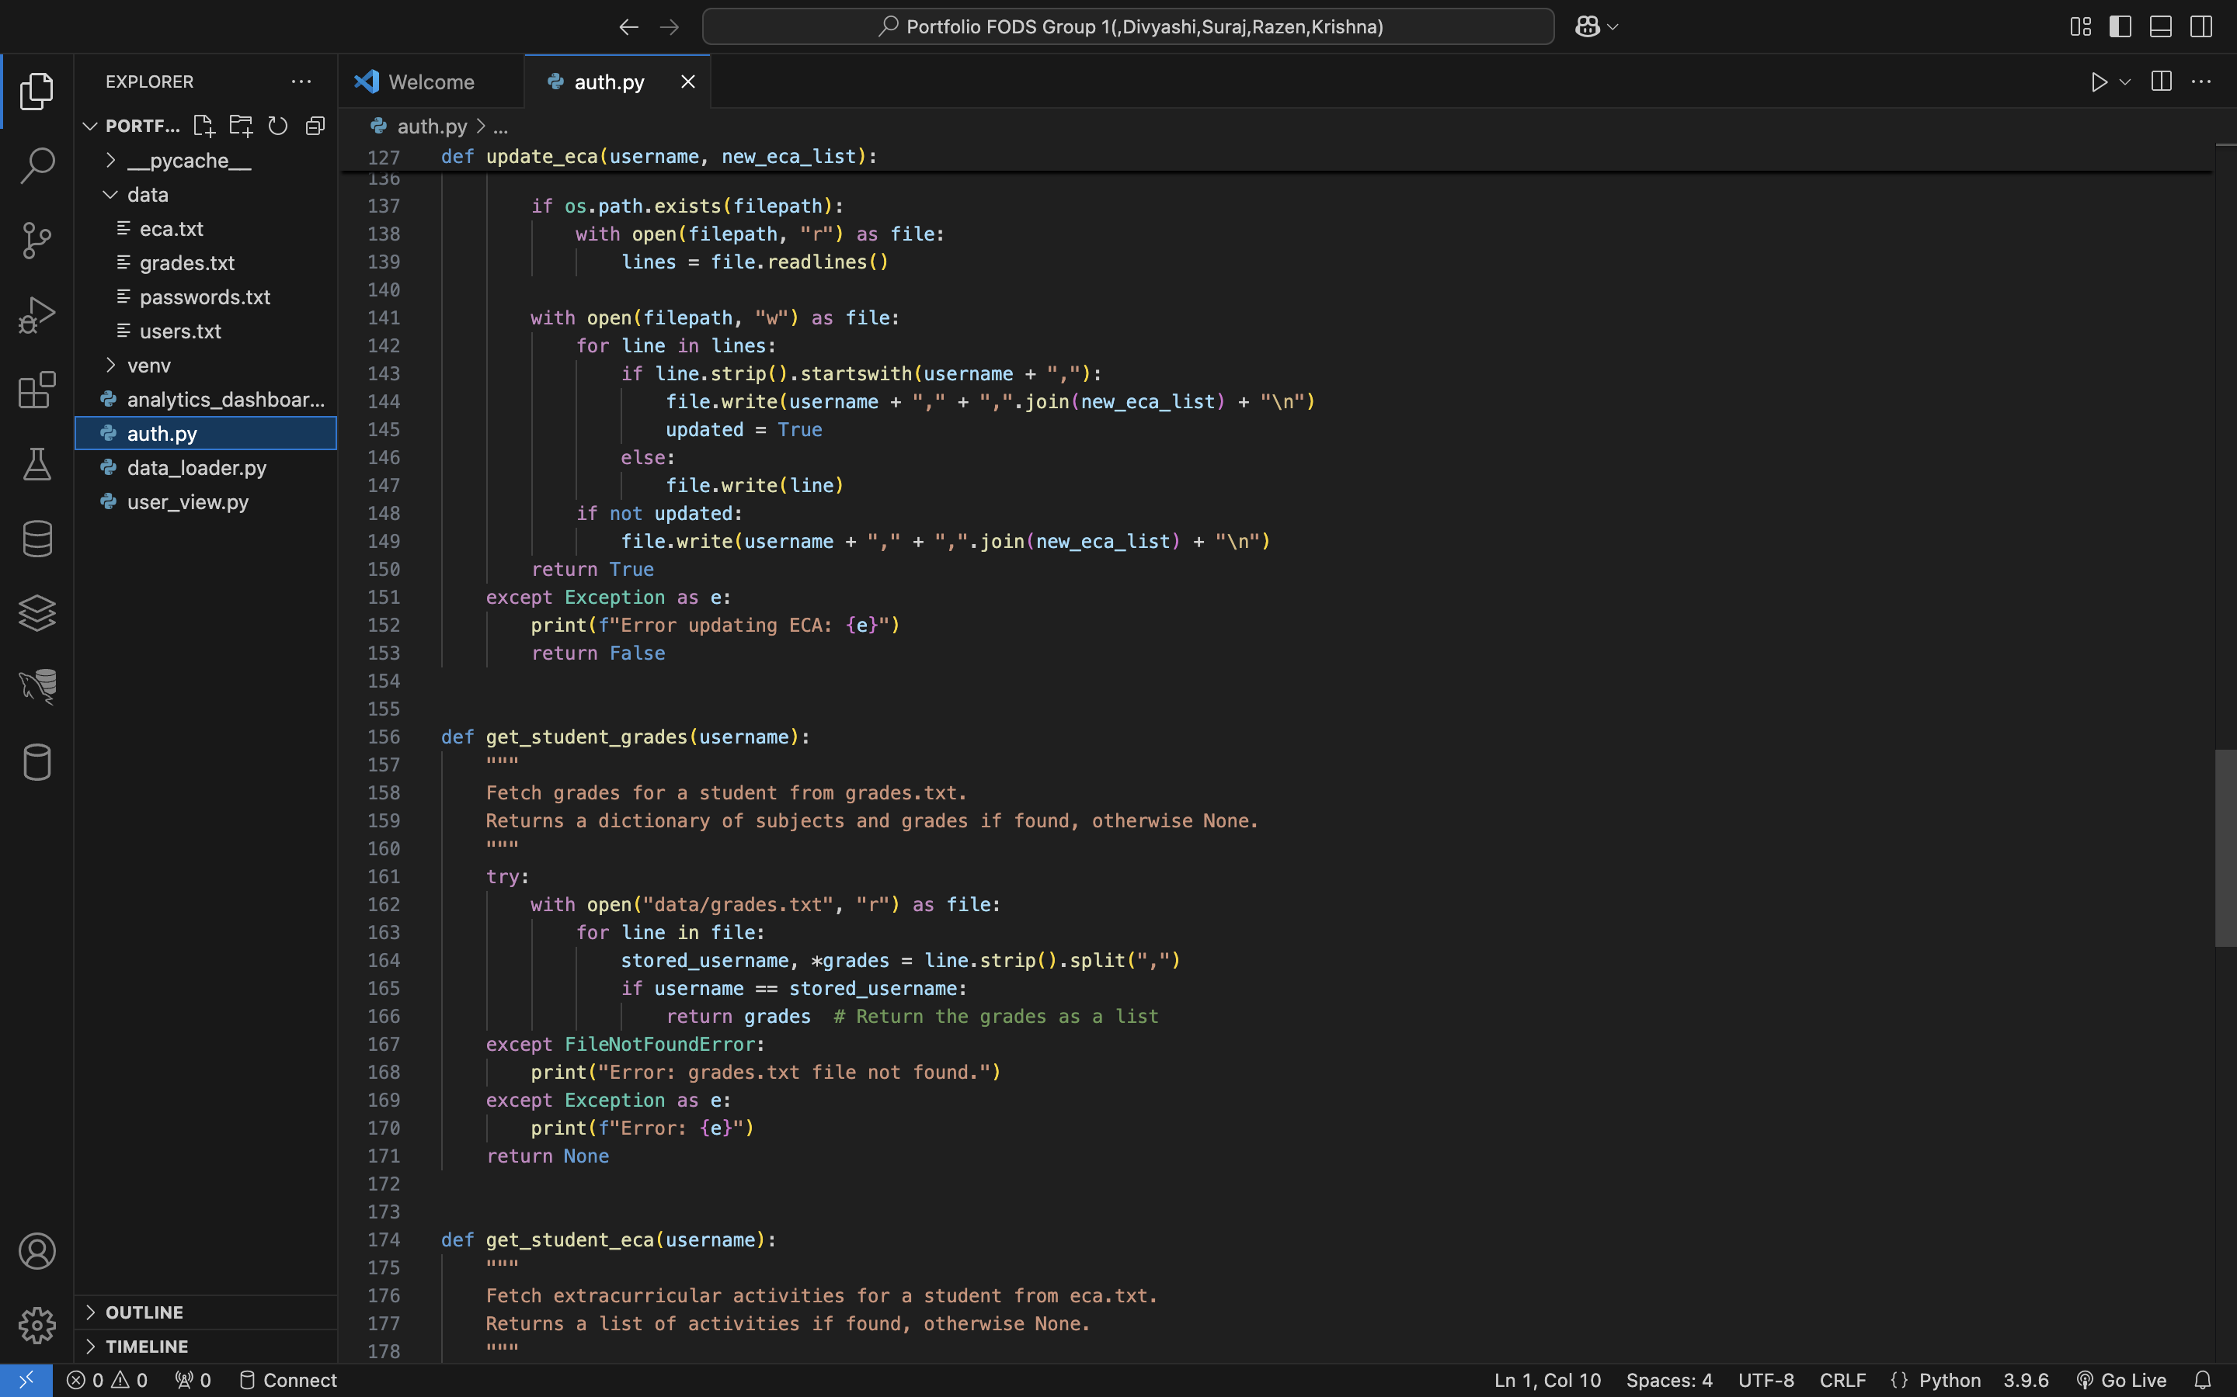

Slide 13
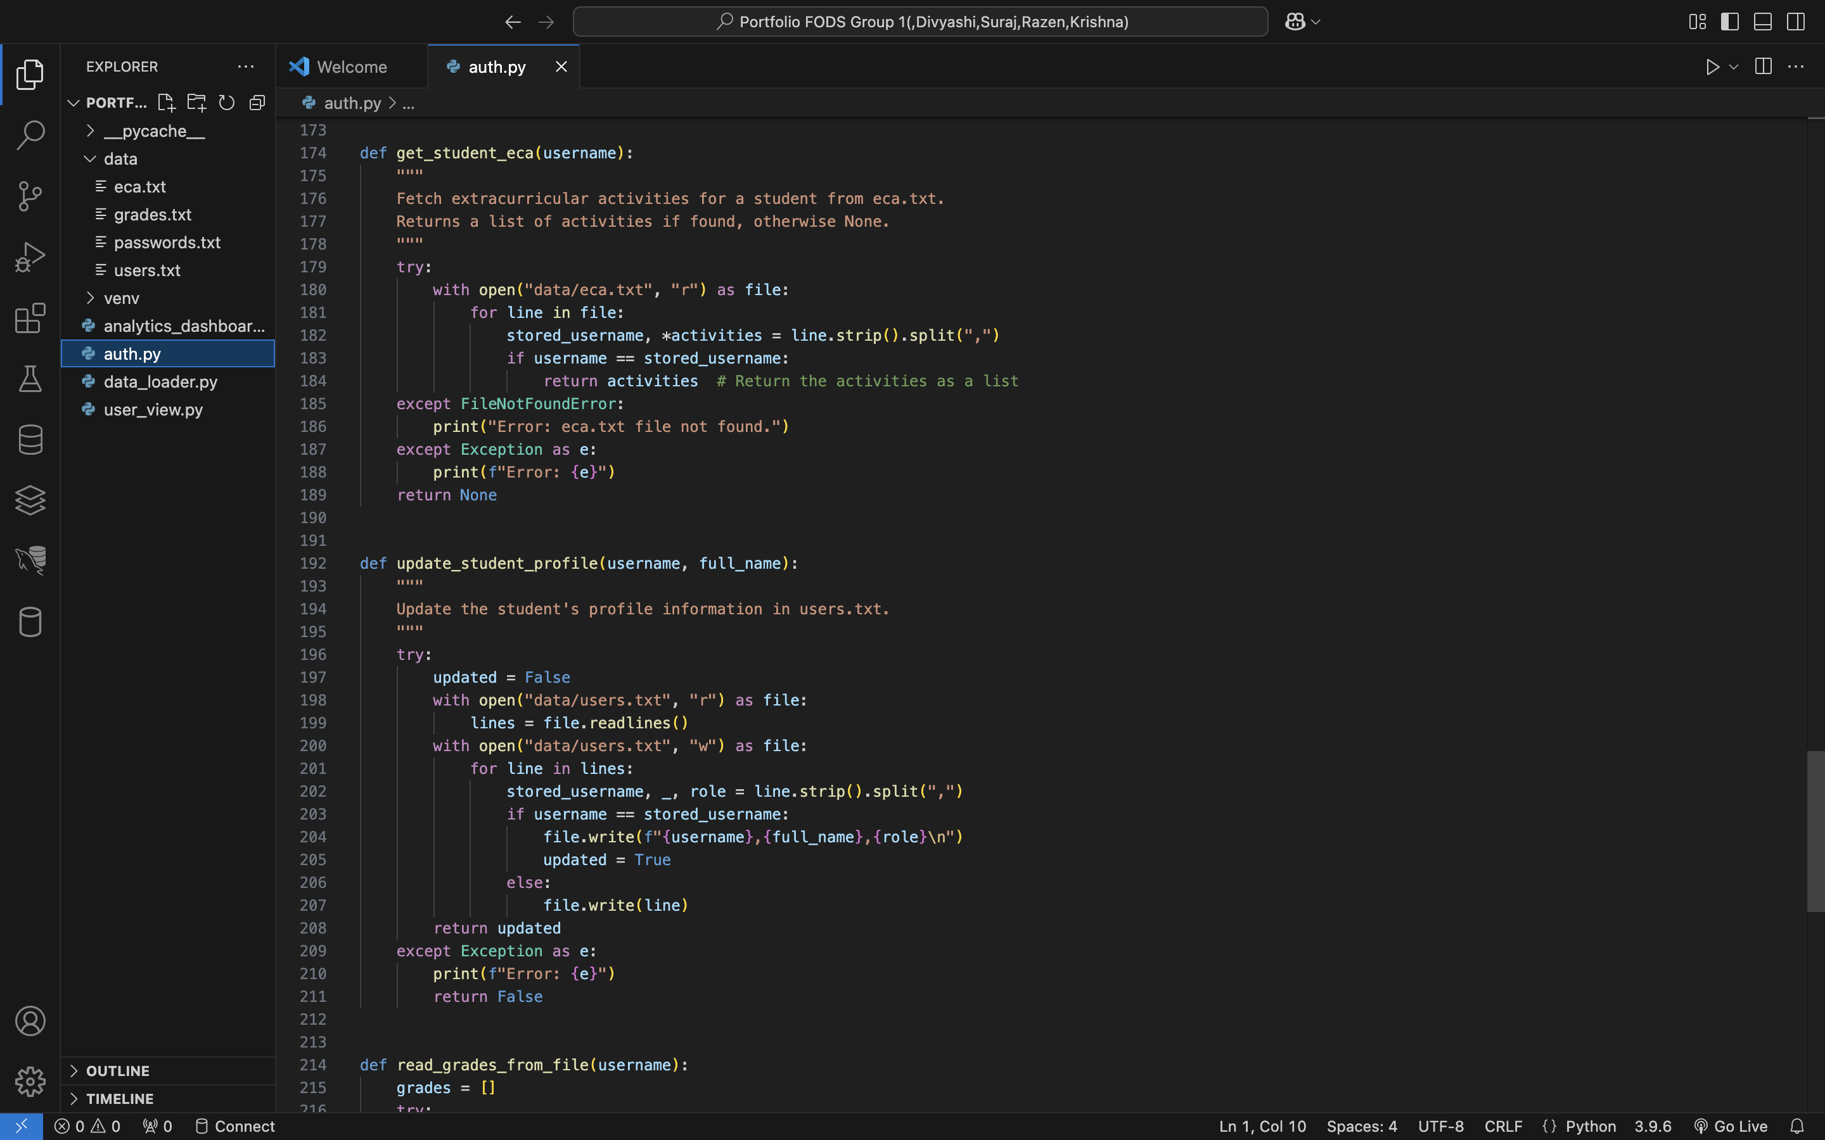
Auth.py upto here

Slide 14
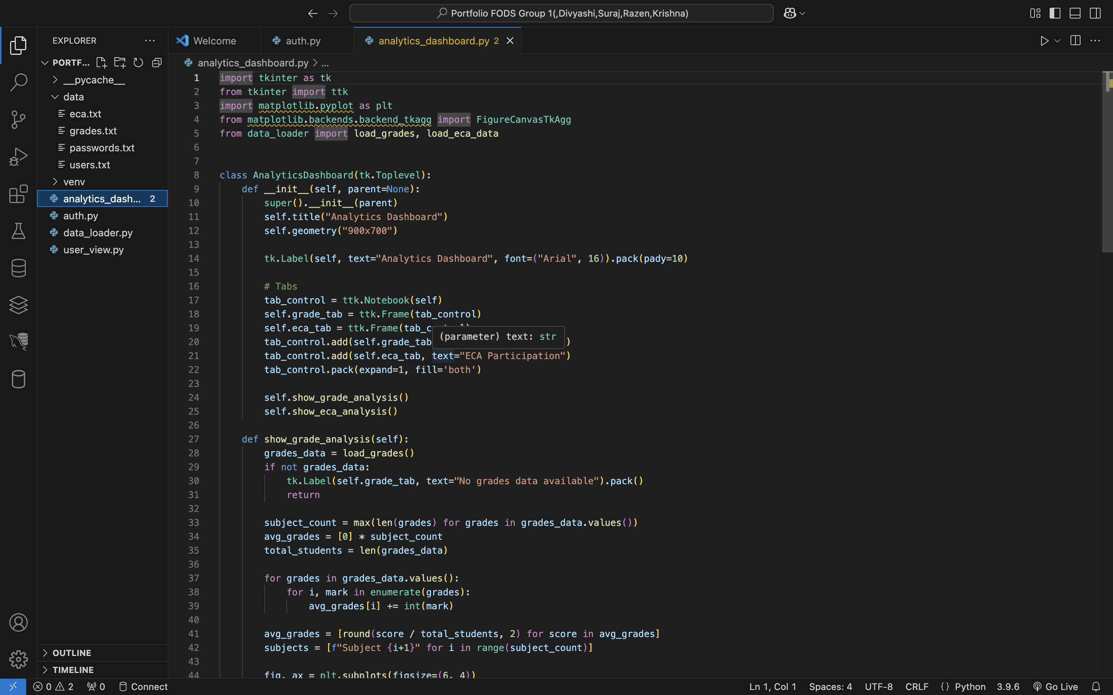
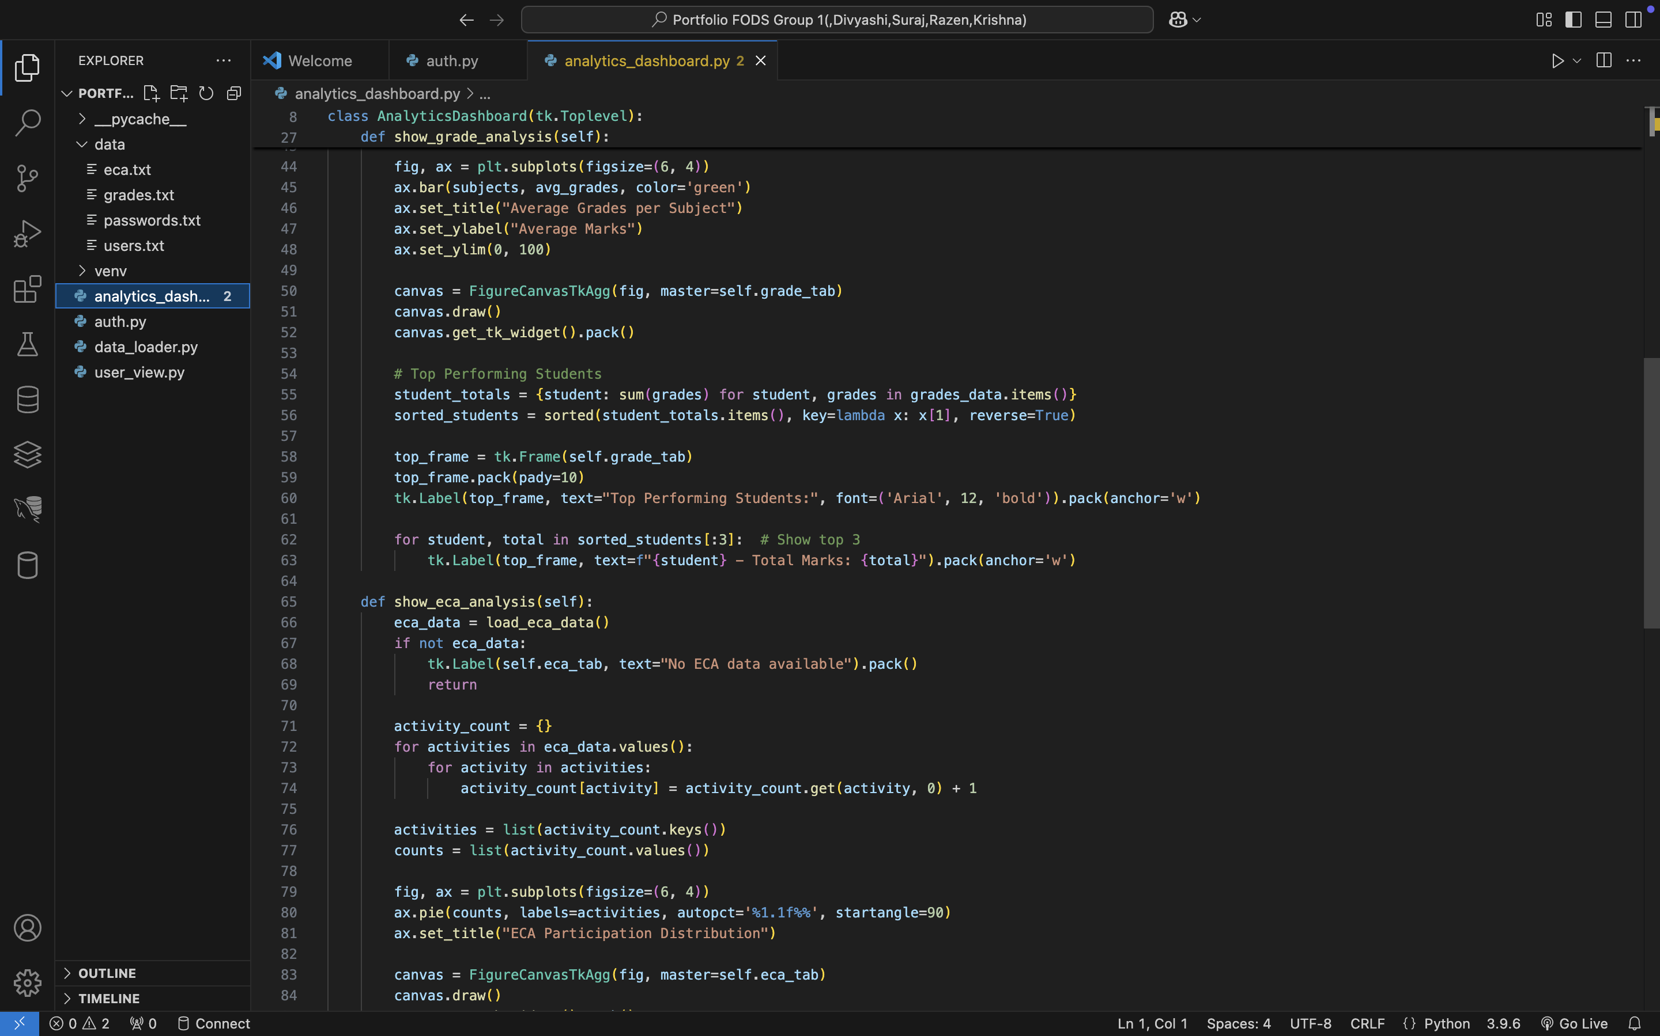
Analytics_dashboards.py

Slide 15
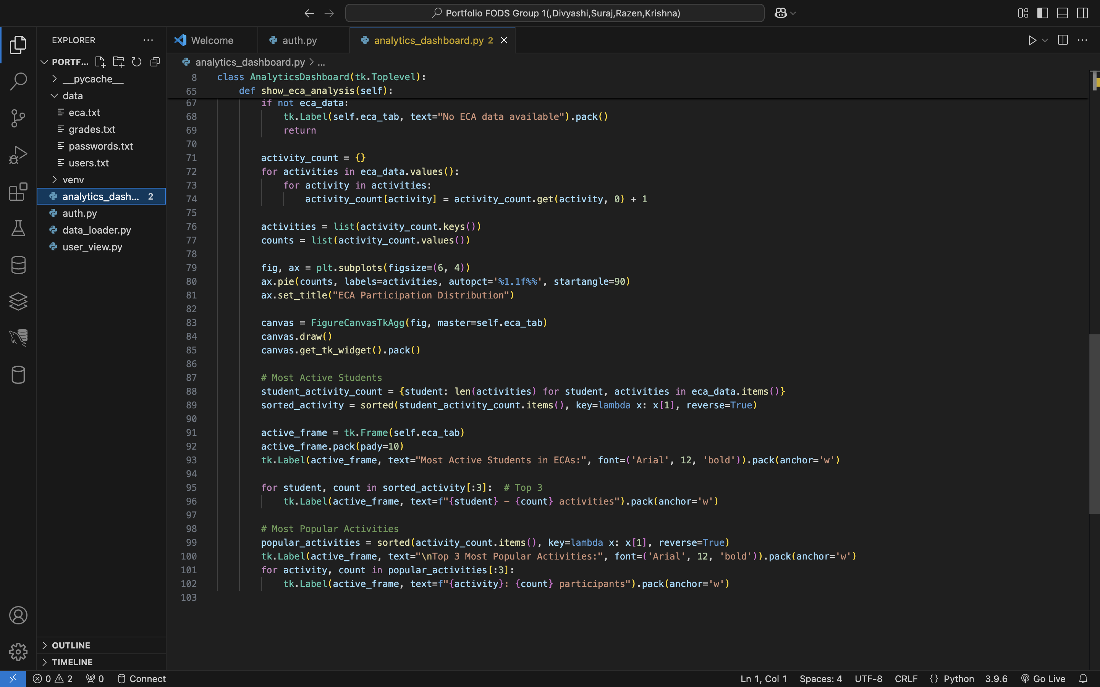

Slide 16
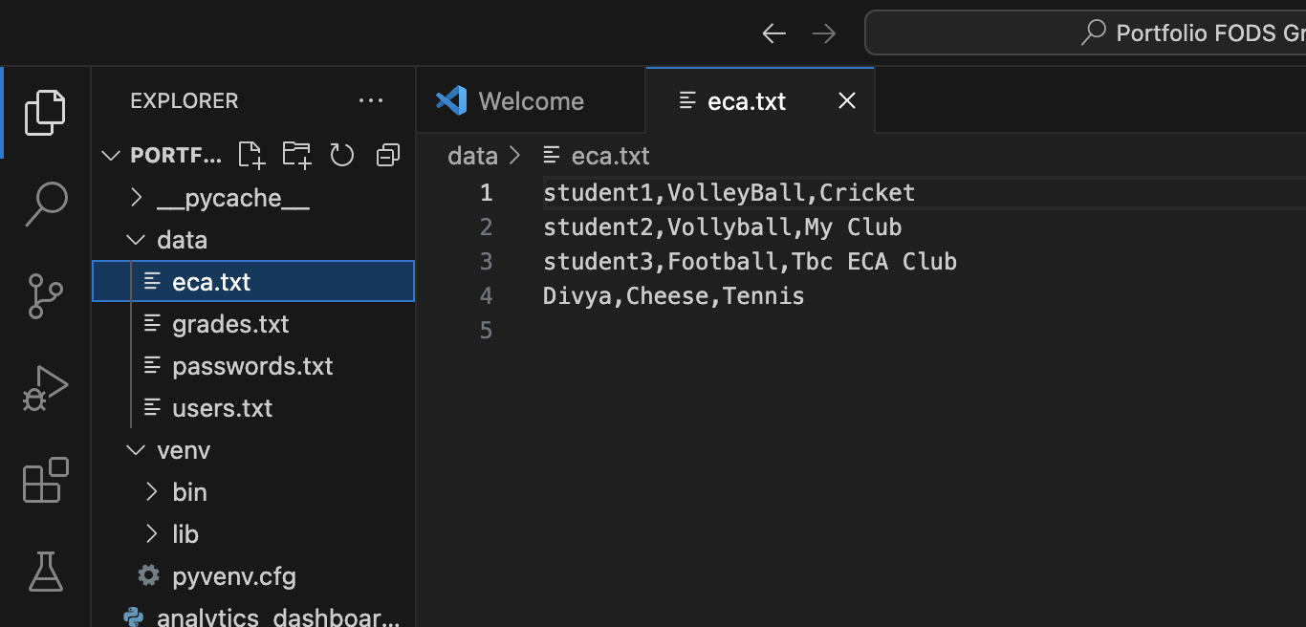
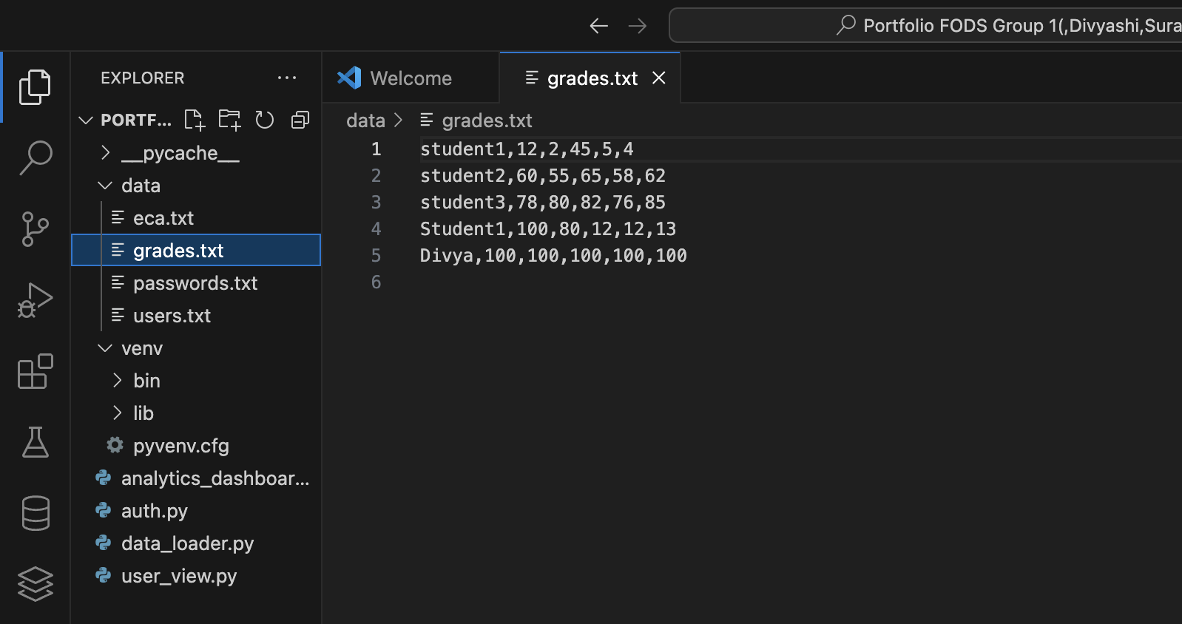
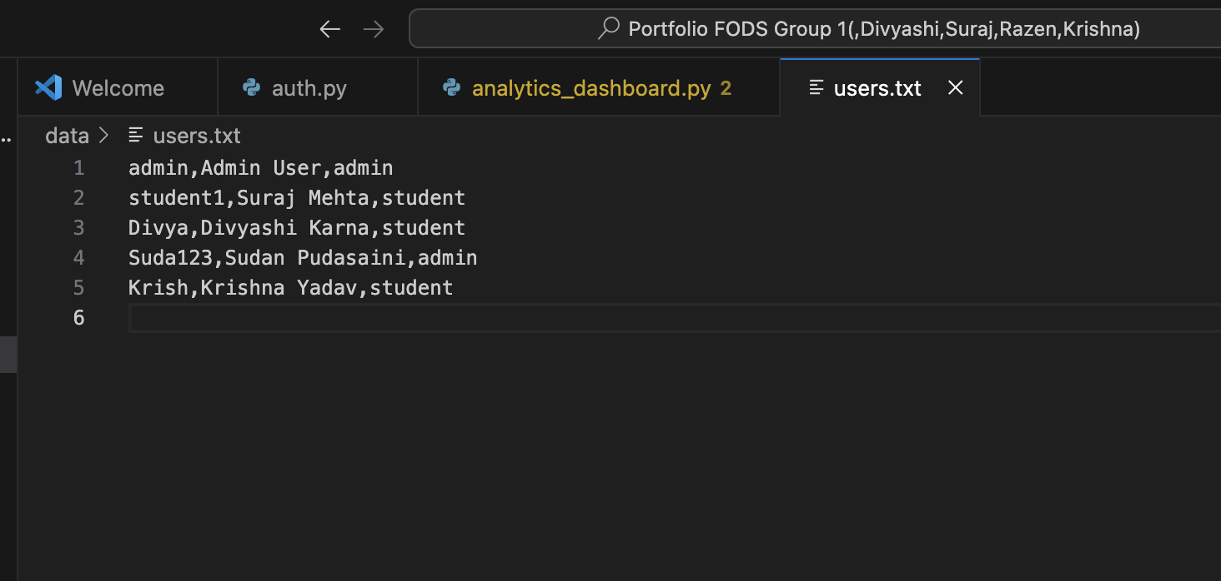
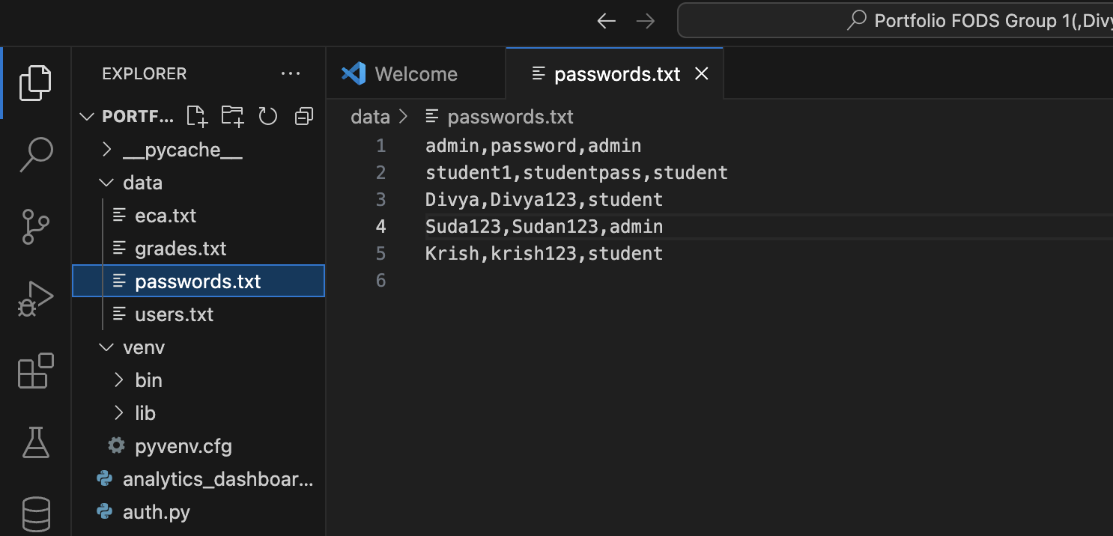
Data

Slide 17
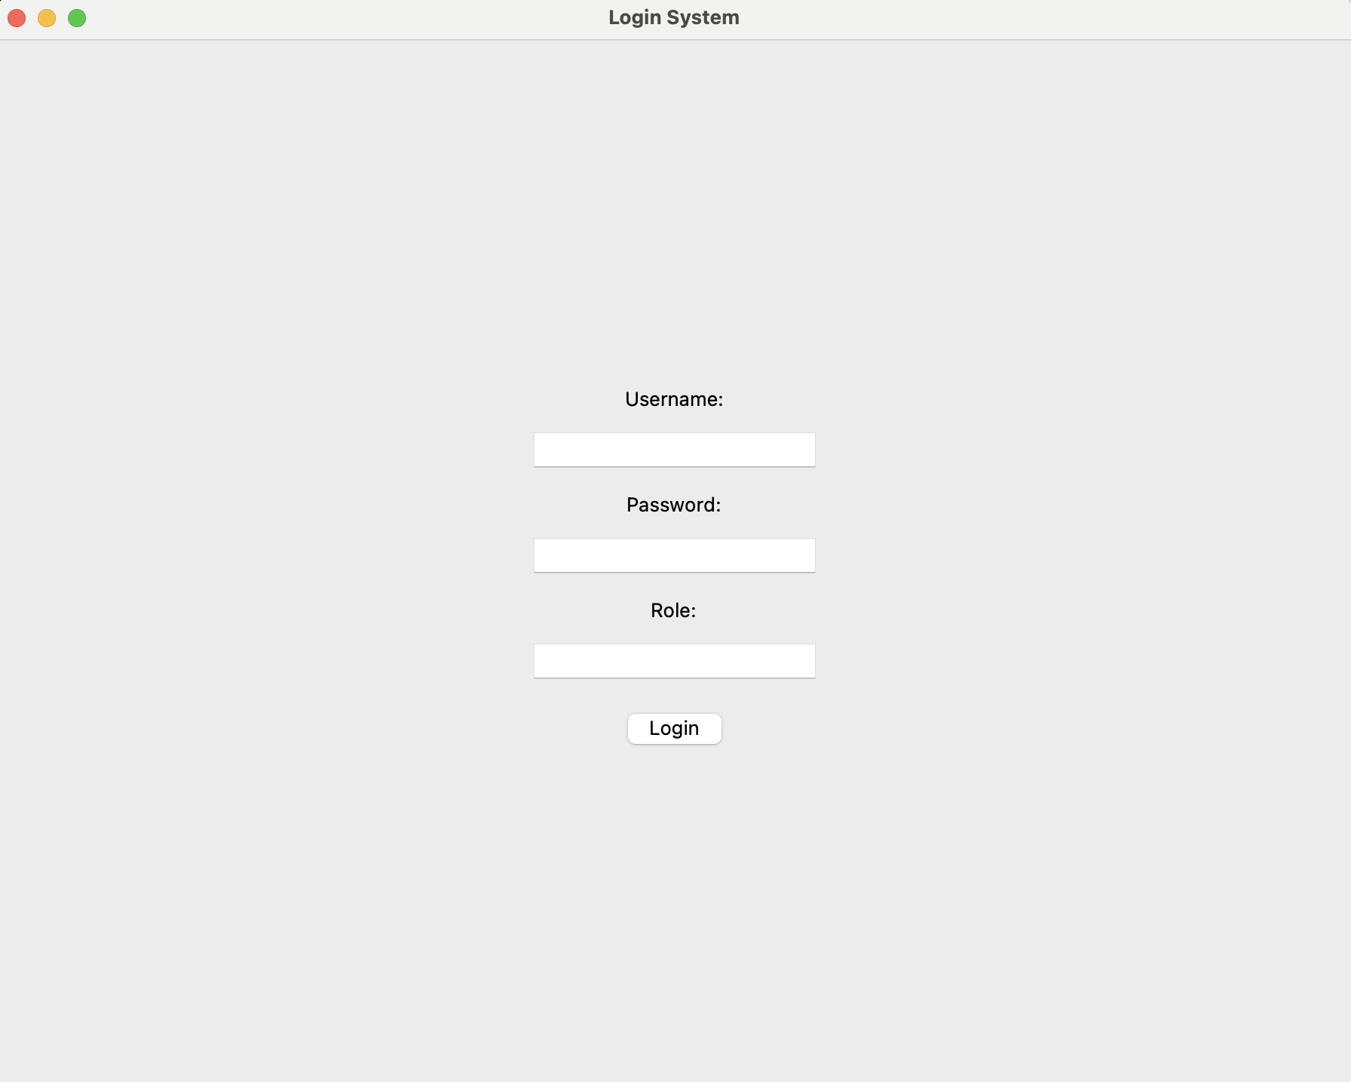
Screenshots of Every Steps:
1.Login Page

Slide 18
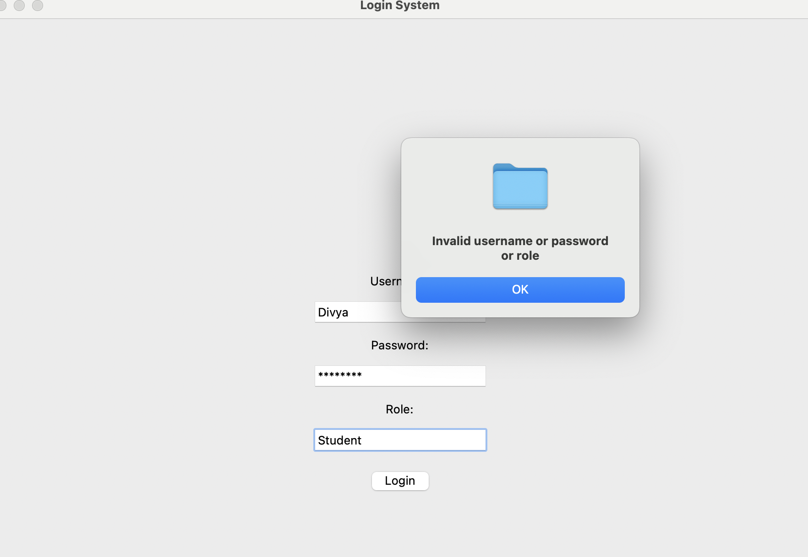
Throwing Error when entering wrong ID or Password or role

Slide 19
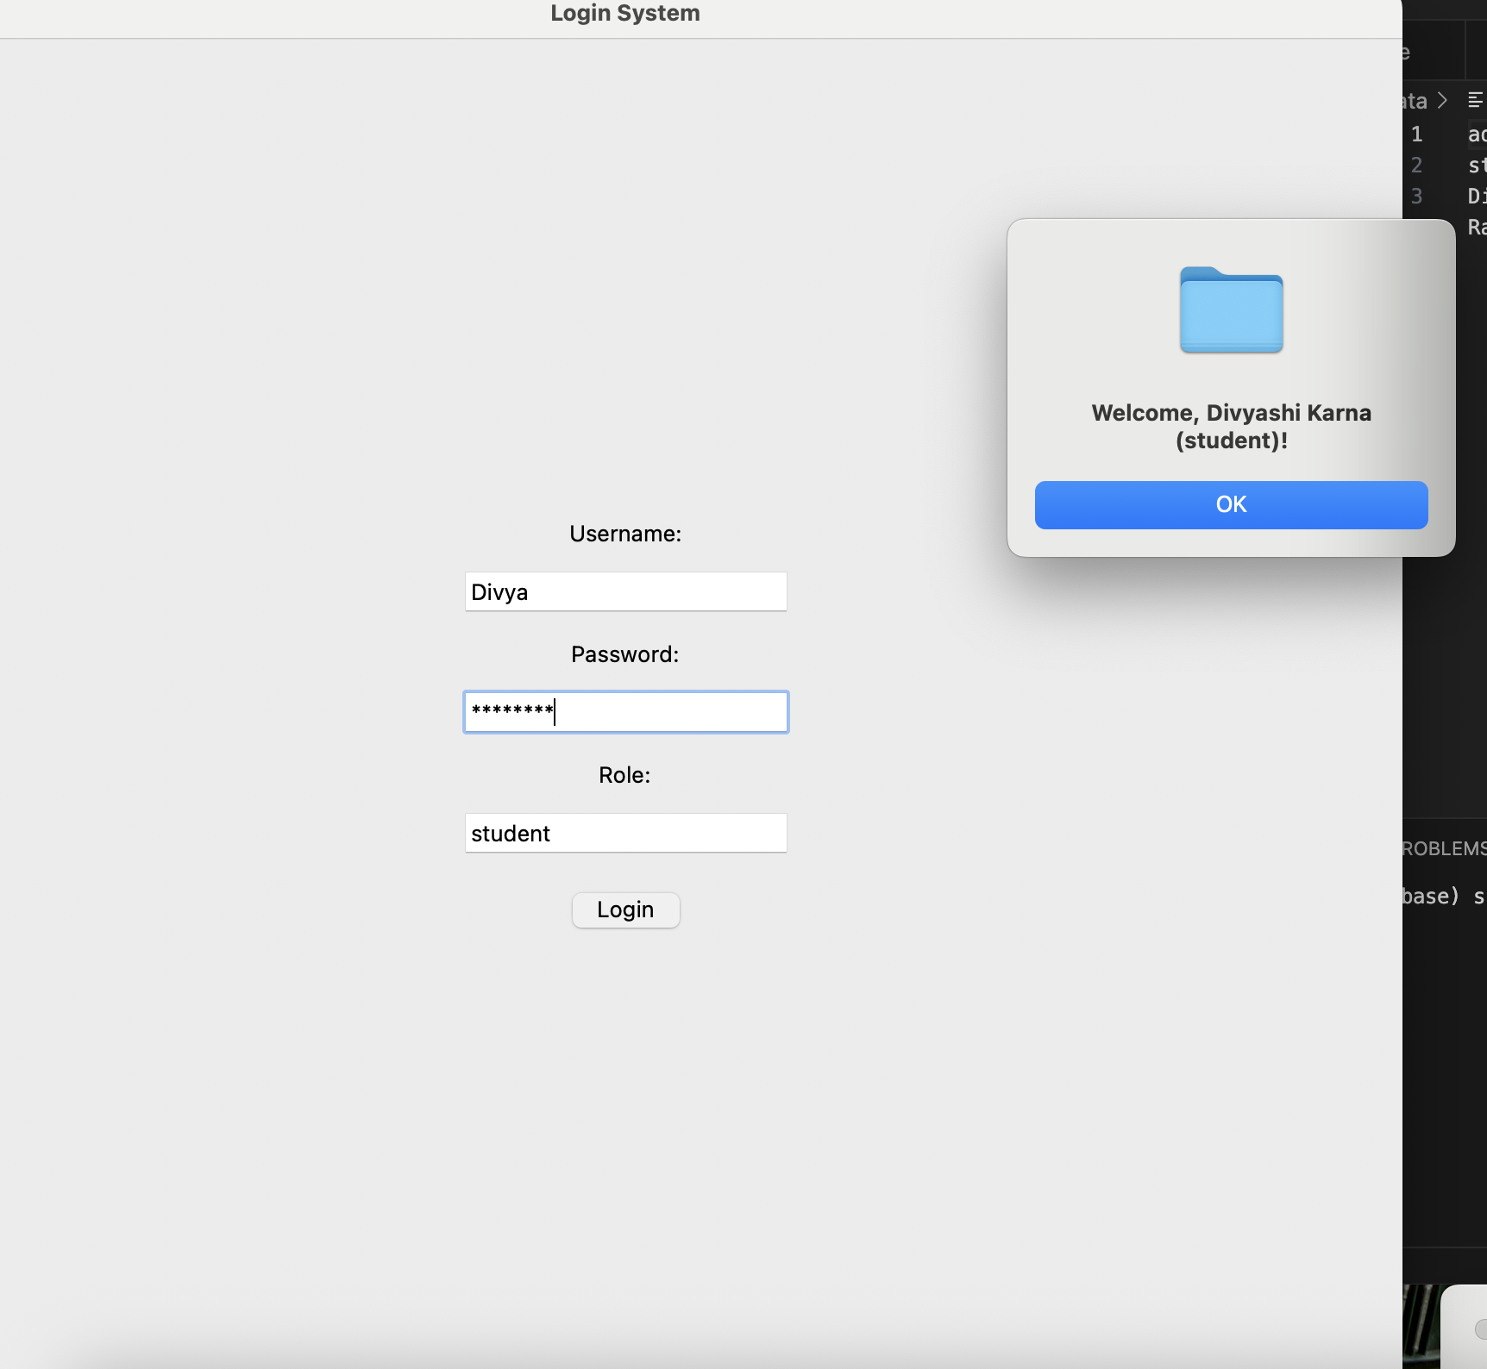
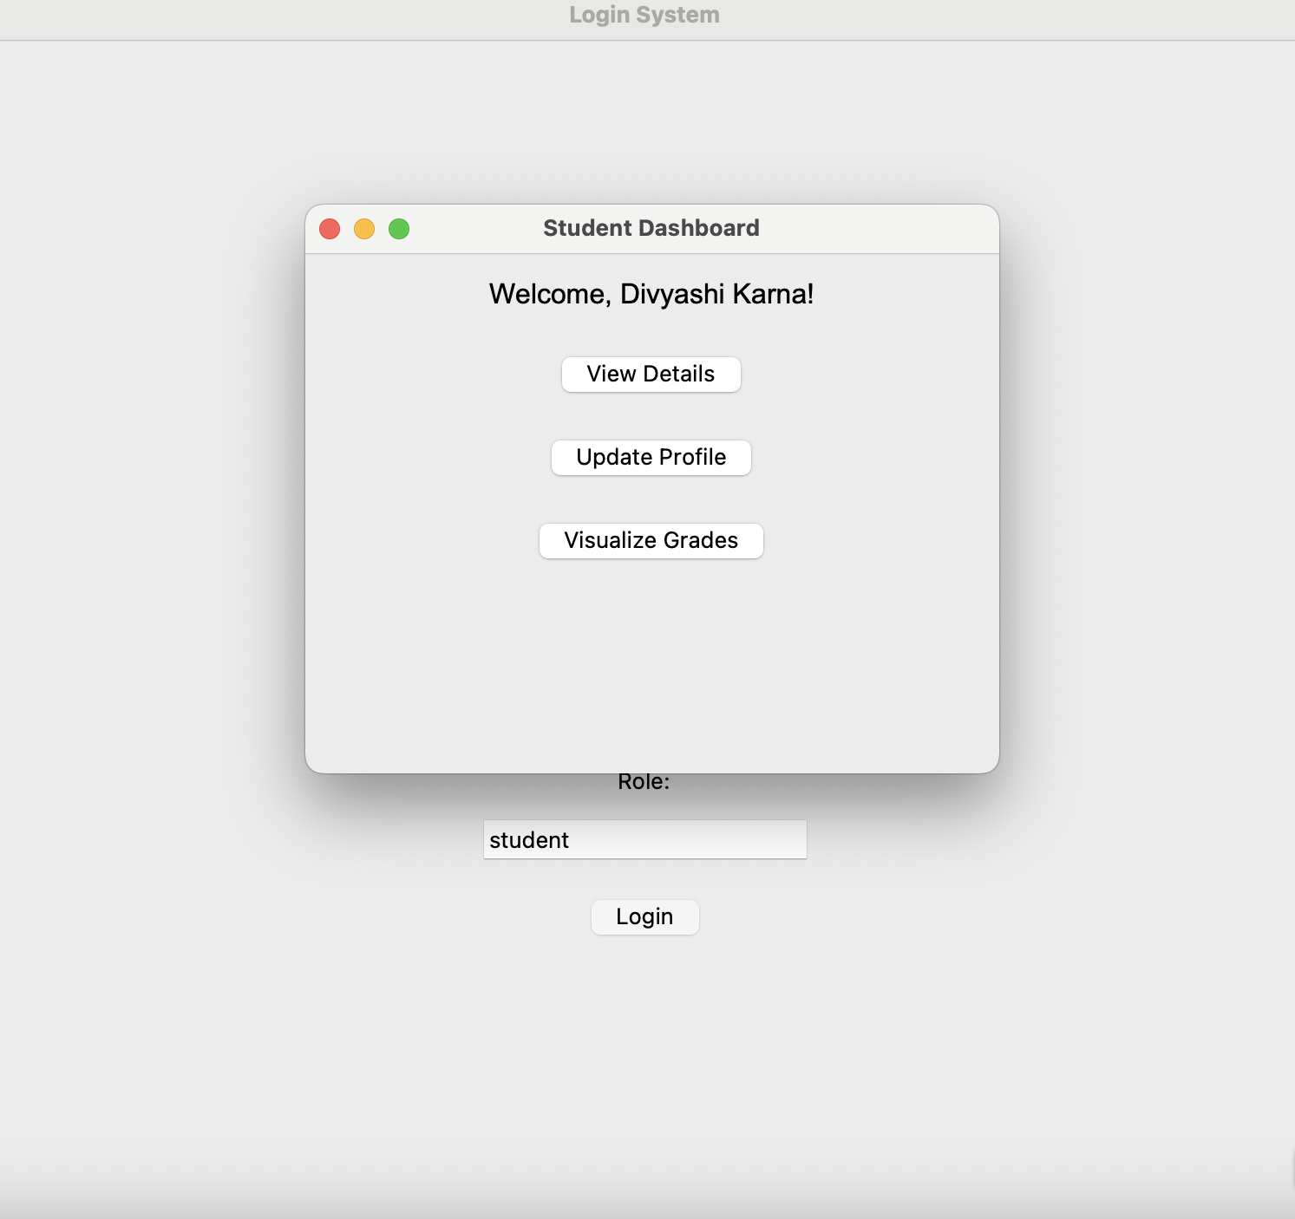
After correct details , Welcome Screen
Student Dashboard

Slide 20
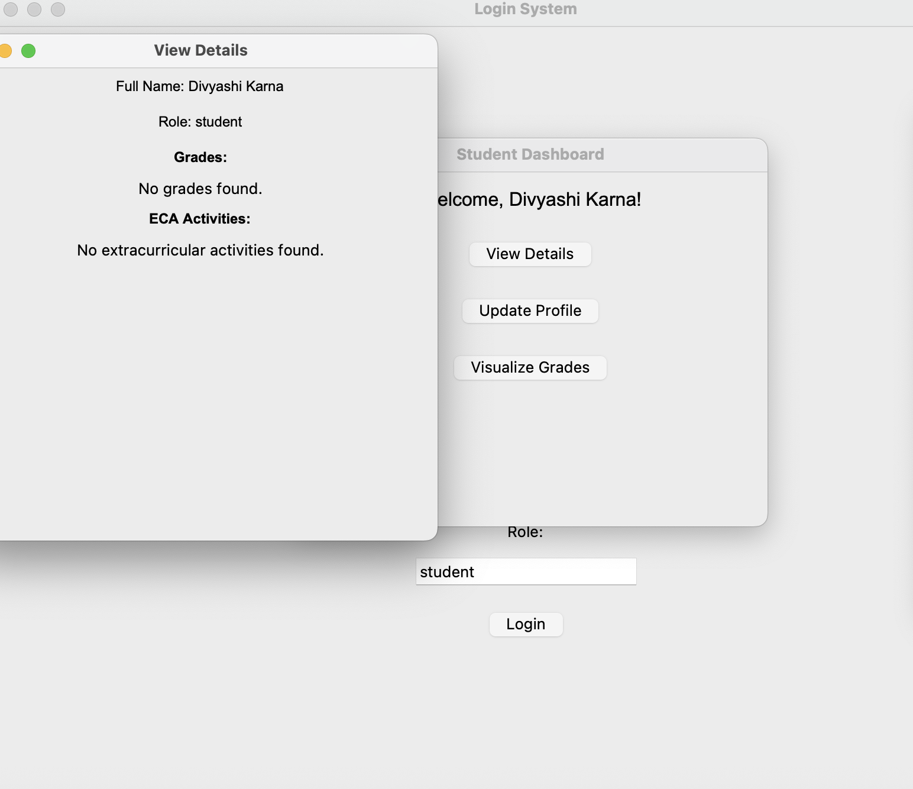
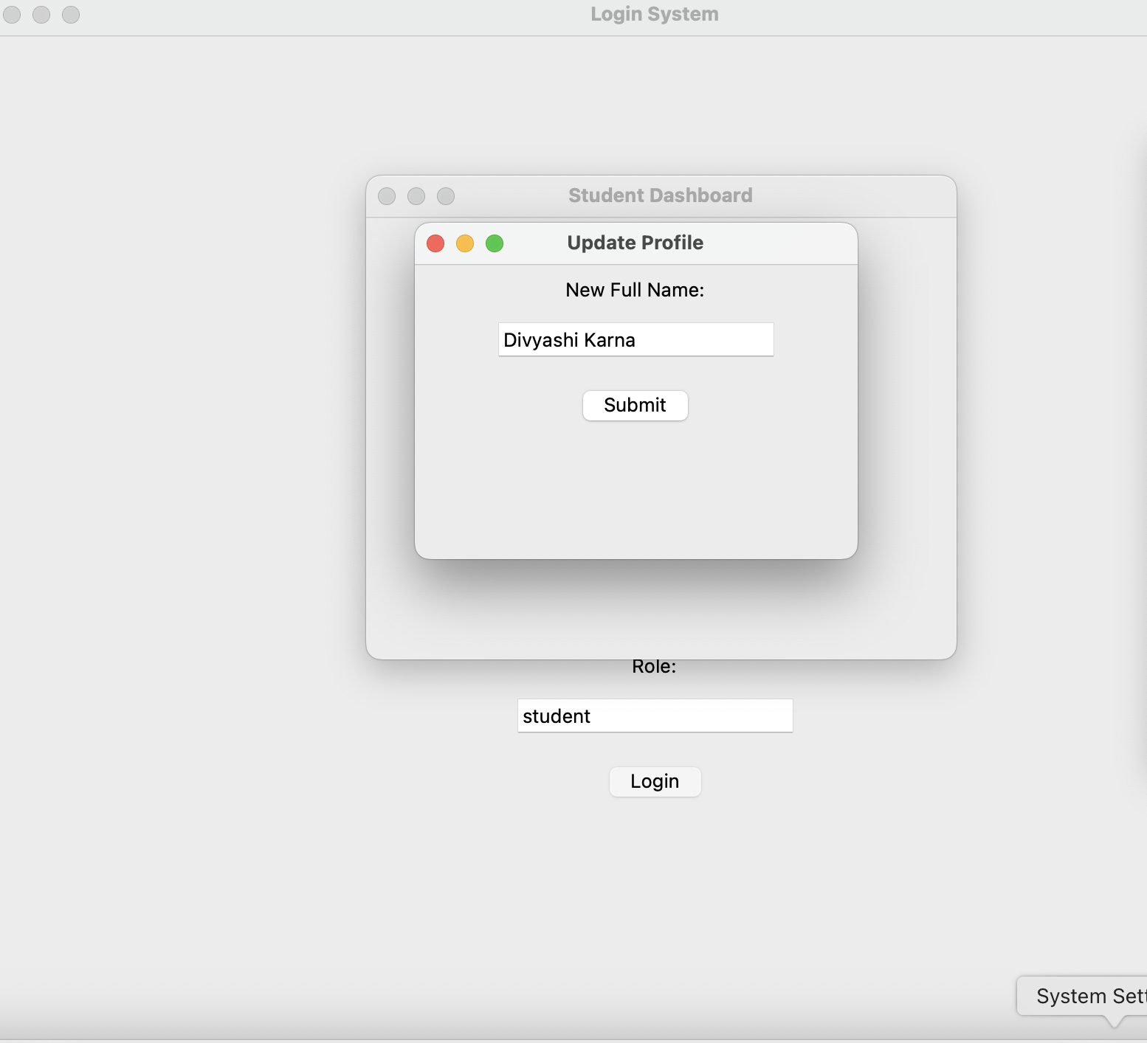
Student Details
Updating Profile

Slide 21
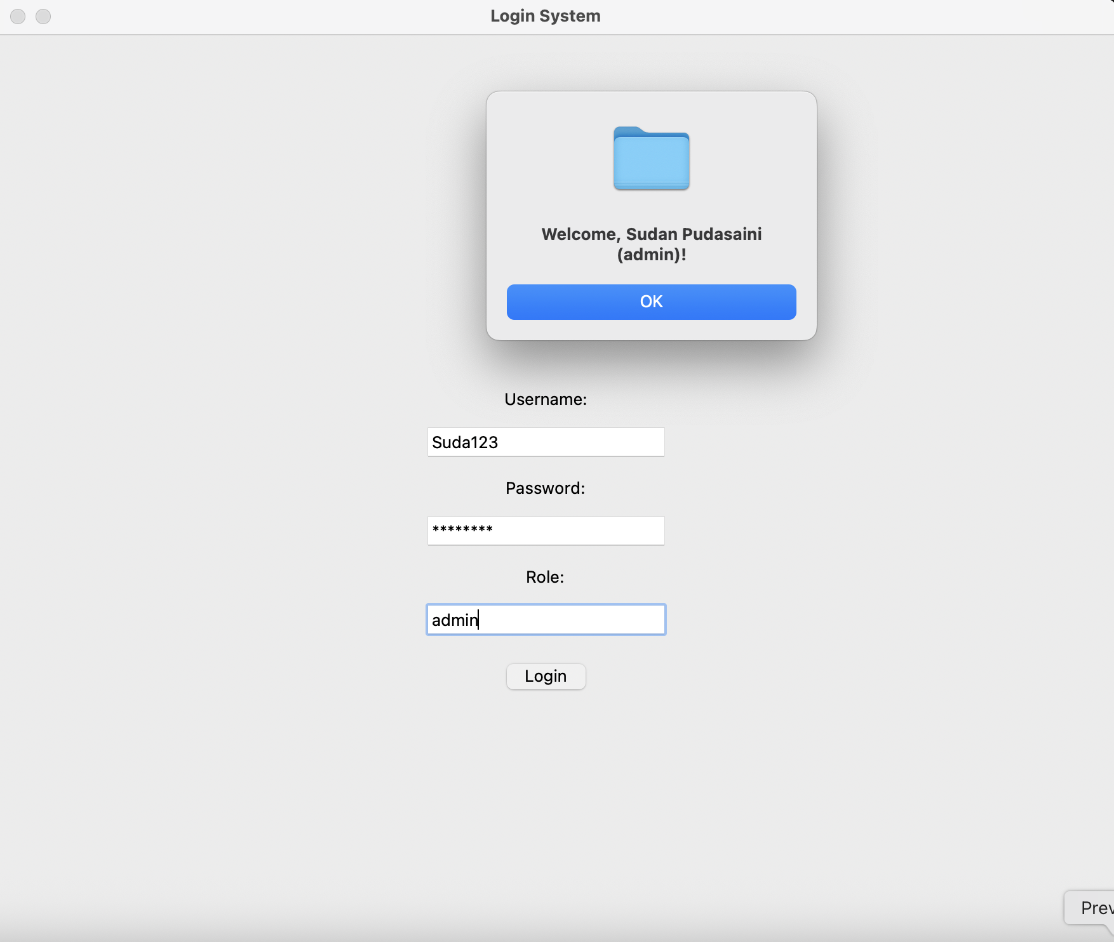
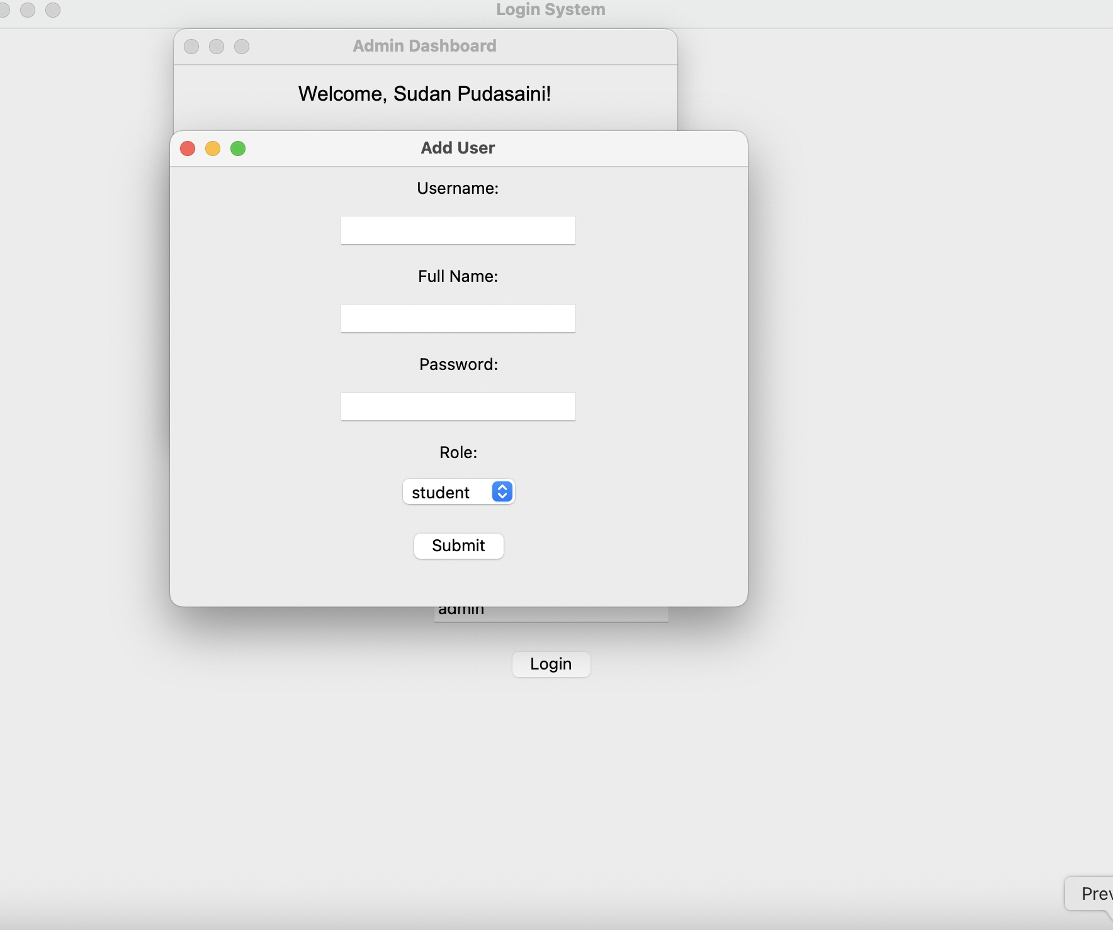
Admin Page
Adding Students By Admin

Slide 22
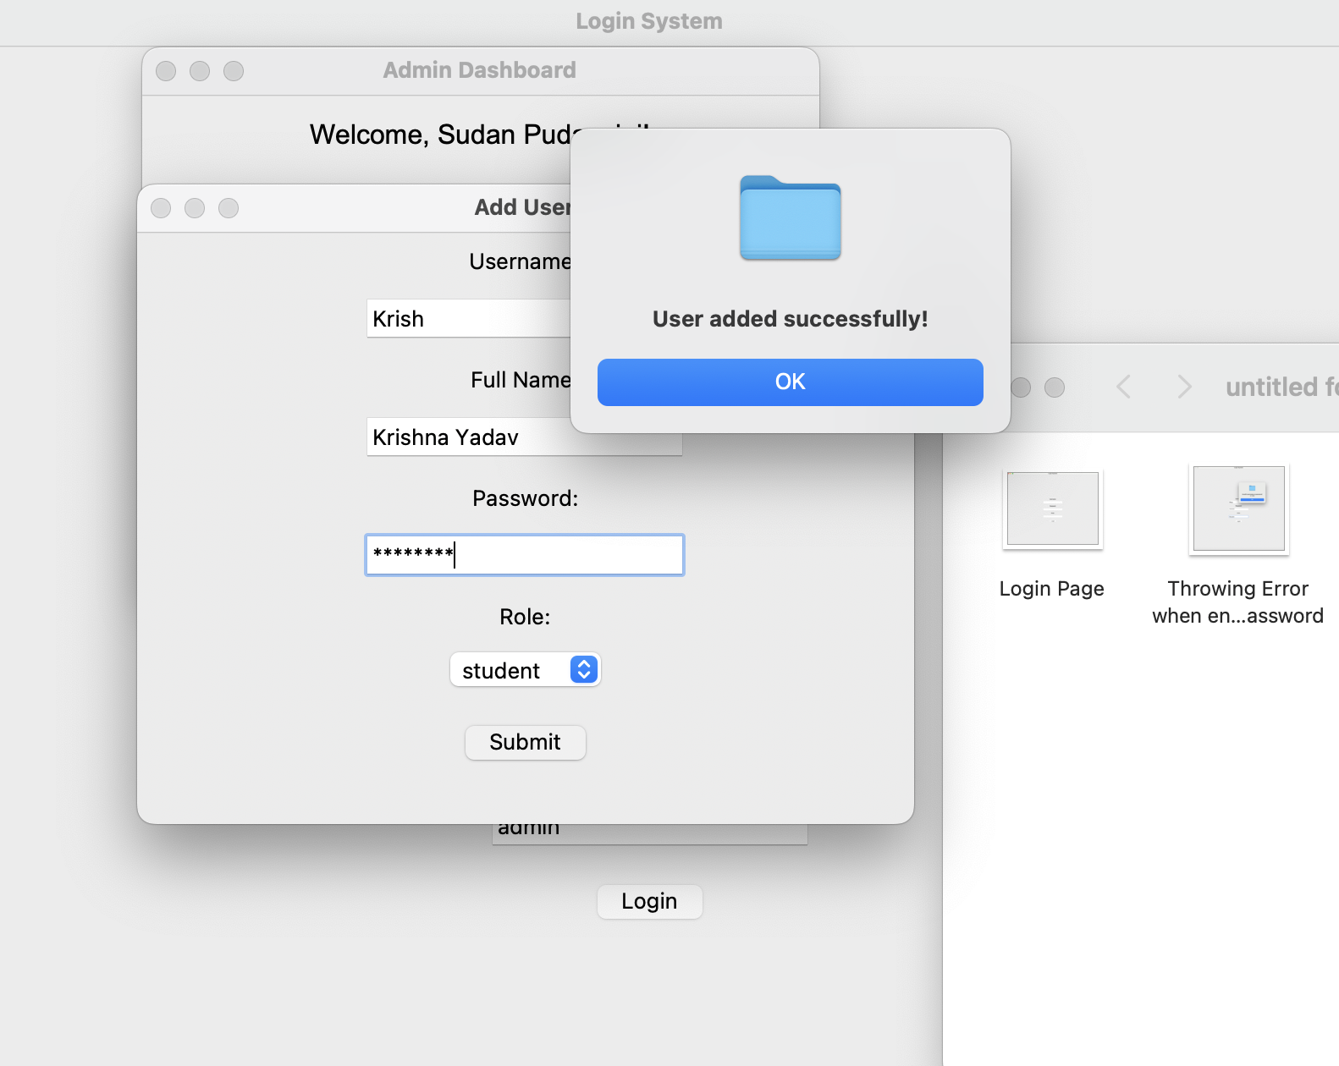
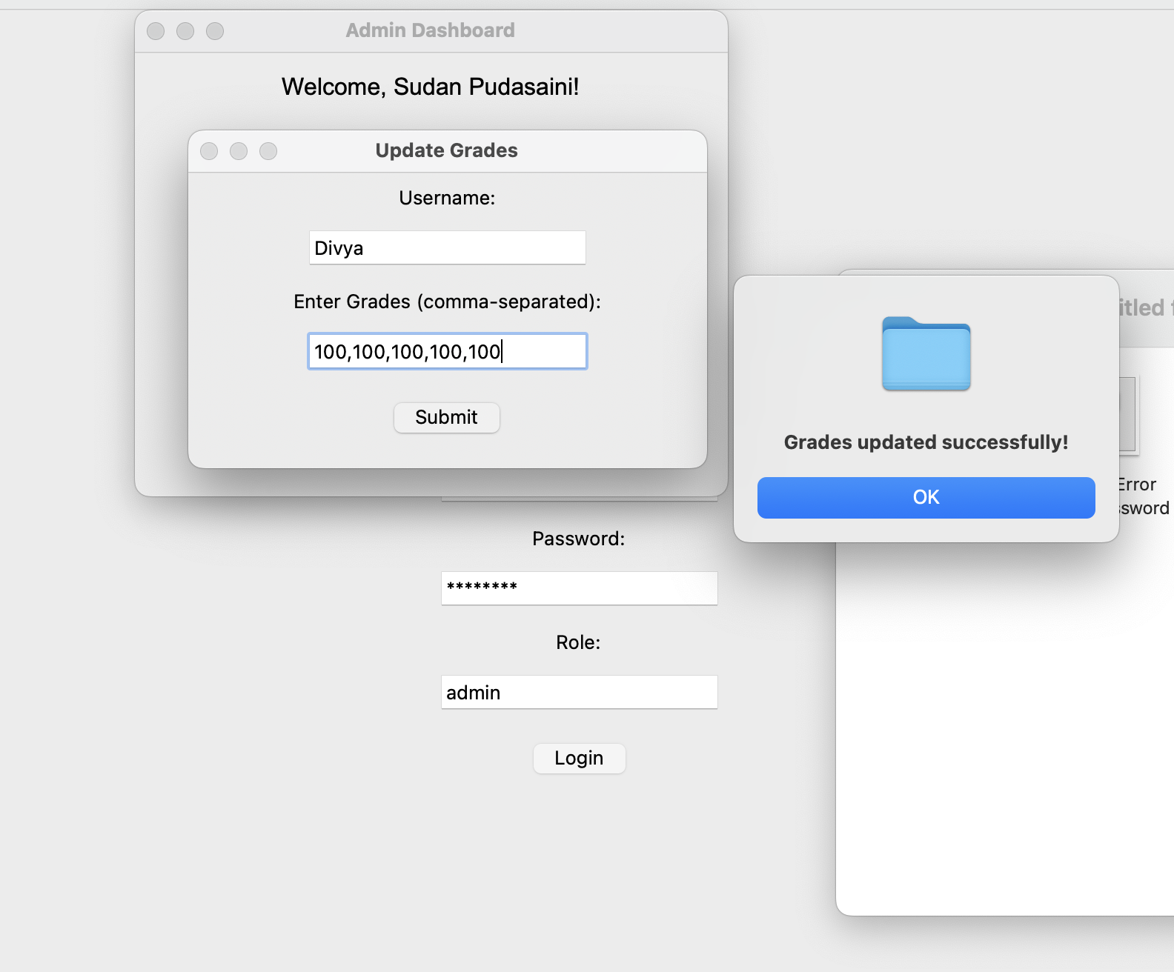
User Added
Updating Grades

Slide 23
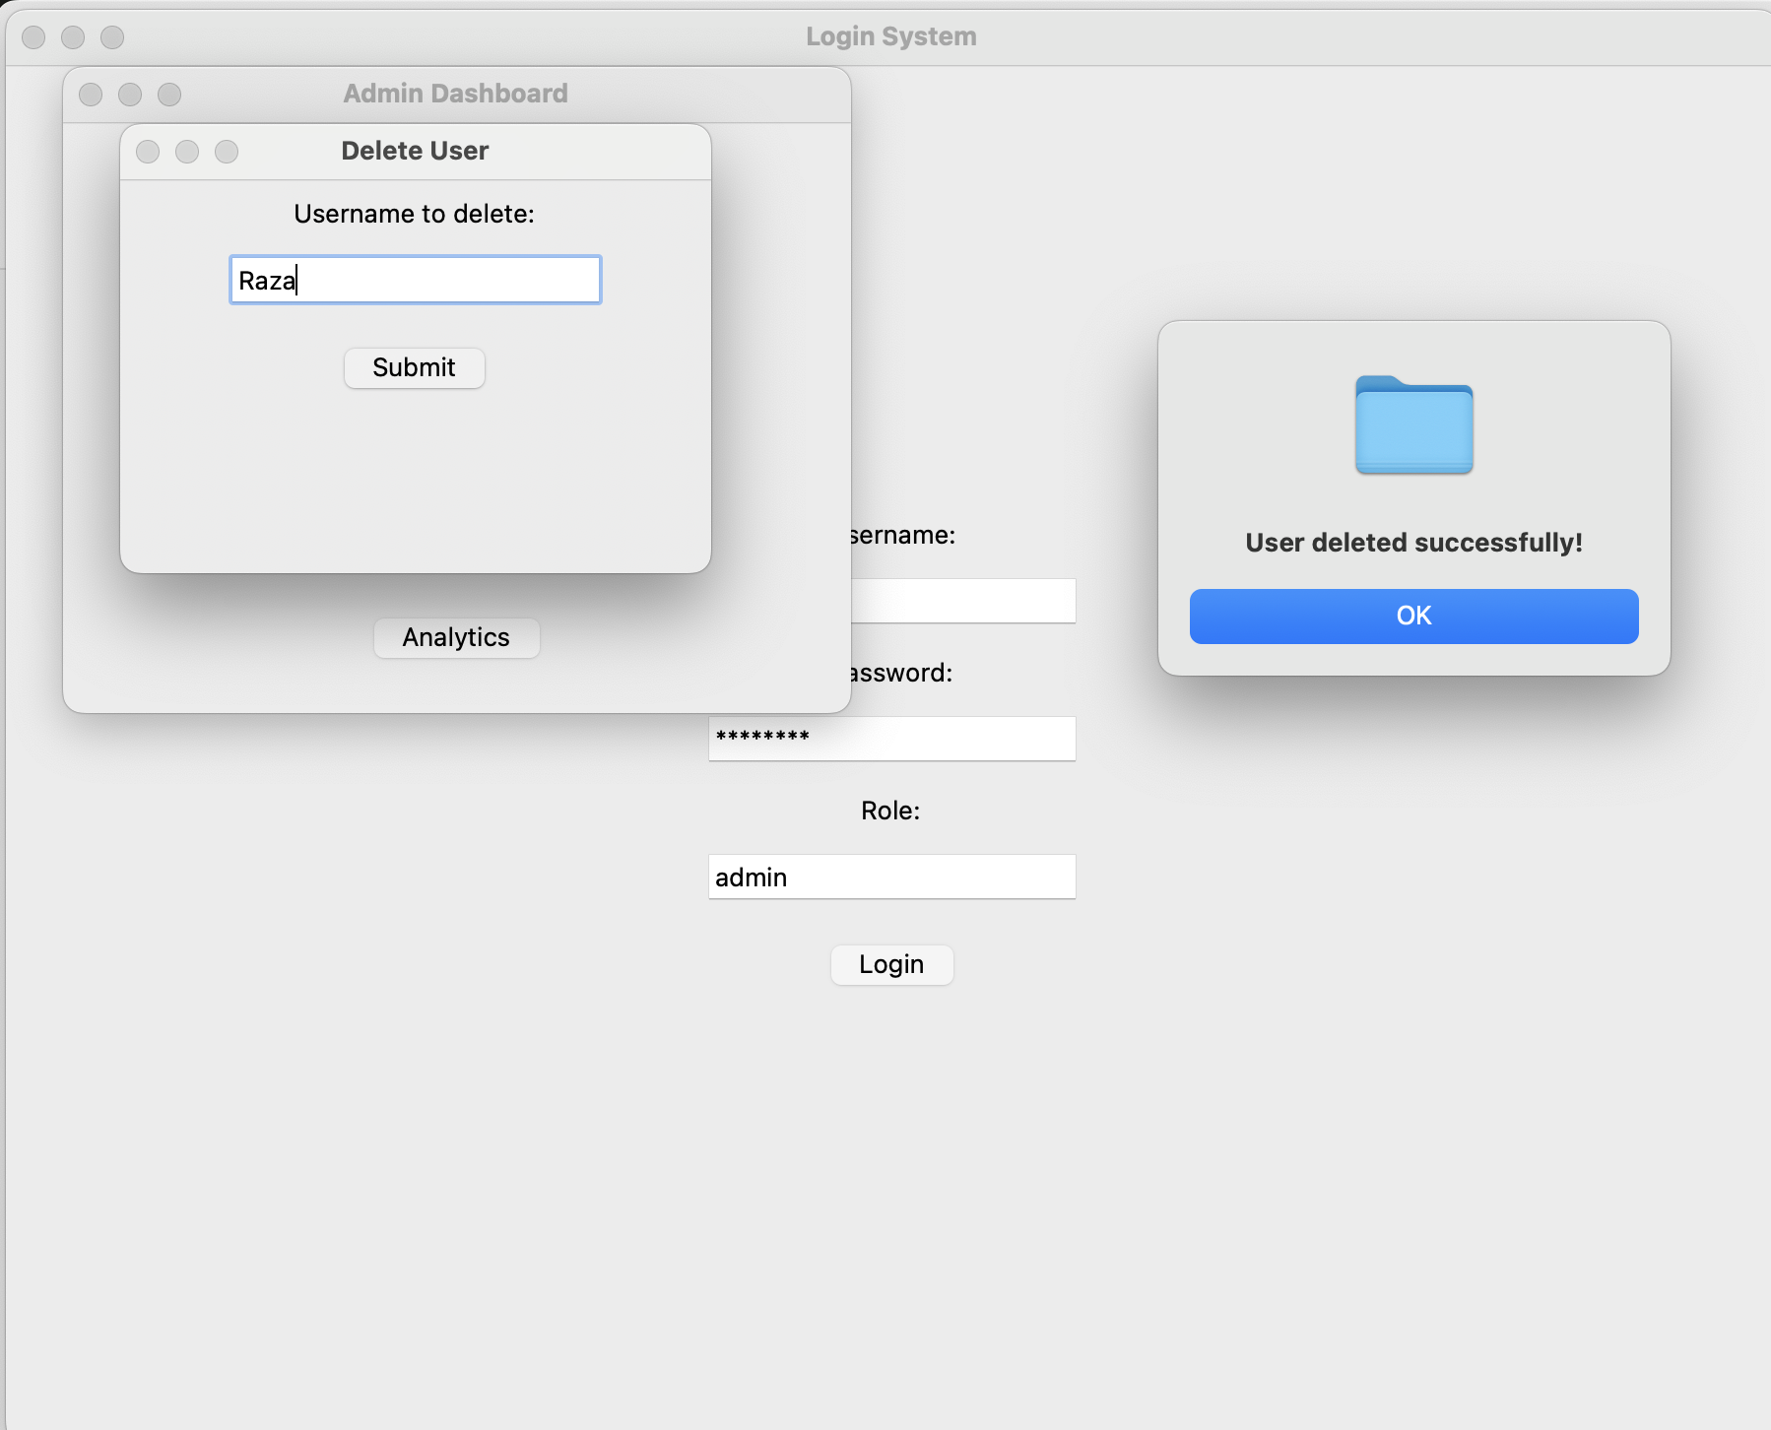
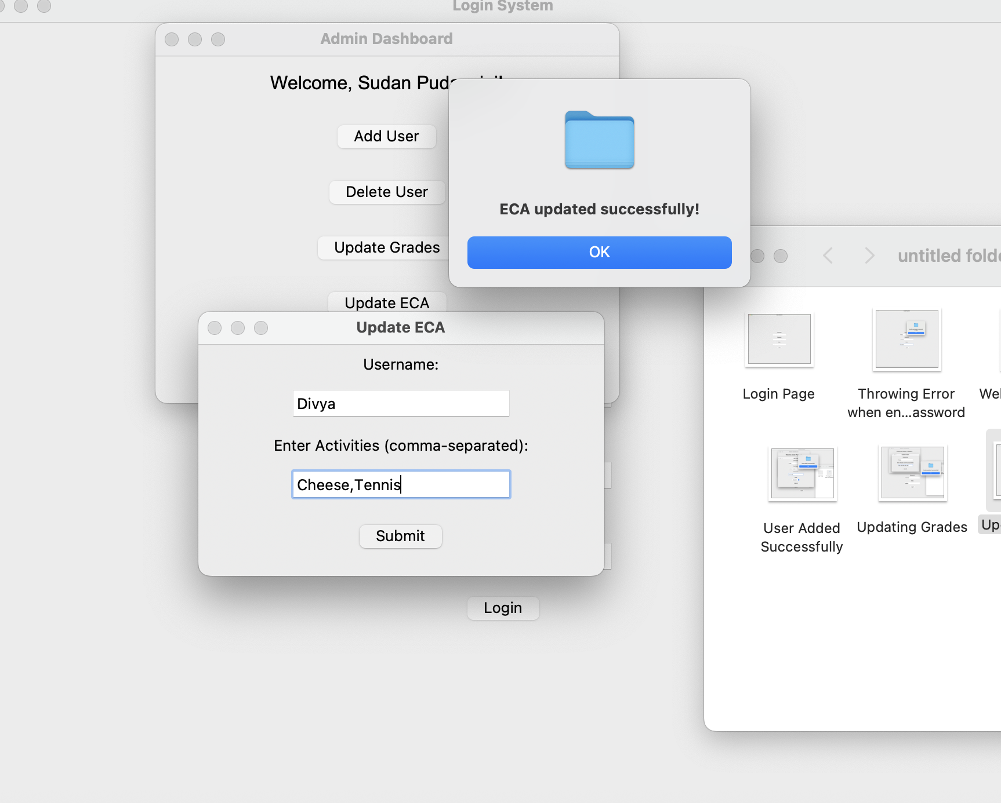
Updating ECA
Deleting User

Slide 24
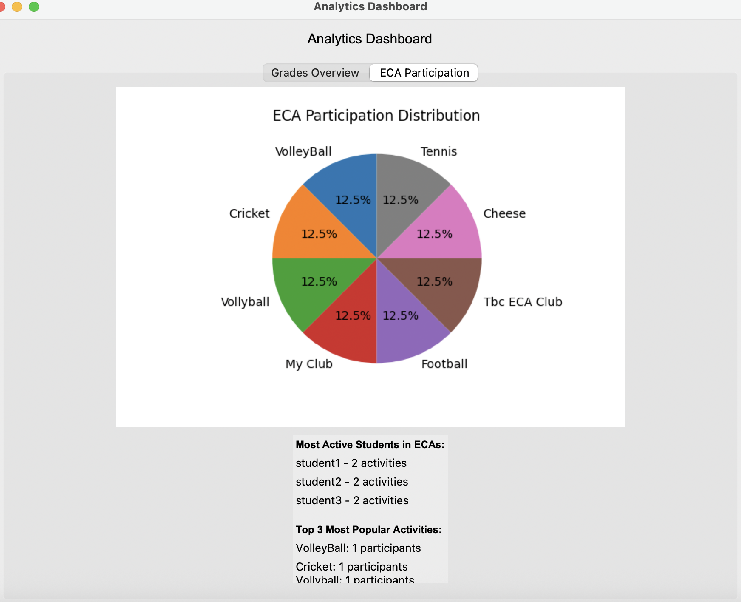
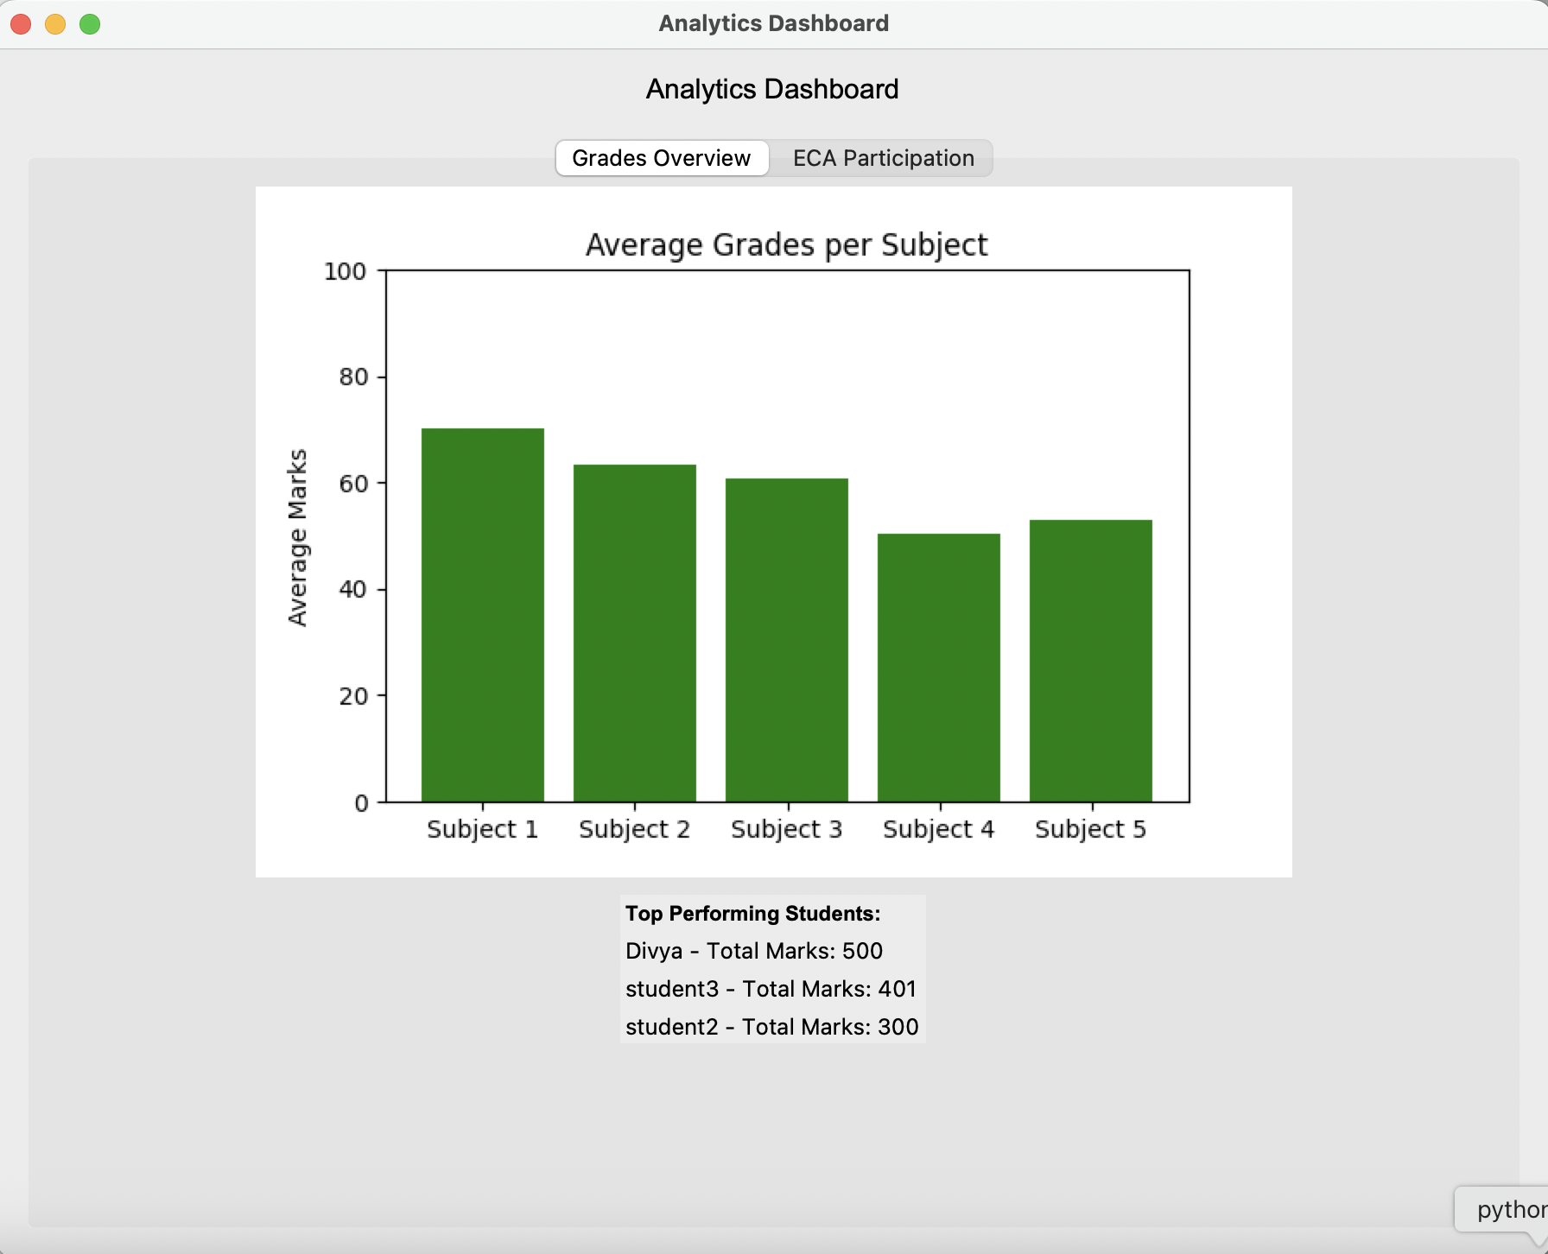
ECA Participation and Grades Overview from Admin panel

Slide 25

📌 Conclusion
The Student Profile Management System successfully demonstrates the integration of essential programming concepts such as Object-Oriented Programming (OOP), file handling, and modular design in a real-world application. By using plain text files for data storage, the project maintains simplicity while still showcasing a full range of functionalities such as login authentication, role-based access, and data management for both admin and student users.
The system not only fulfills all the basic requirements outlined in the task but also incorporates creative features such as data visualization and analytical insights, which enhance the overall usability and value of the application.
This project lays a strong foundation for more advanced systems and could be further extended with a graphical interface, password encryption, or database integration to make it production-ready.

Slide 26
Acknowledgments
I would like to extend my heartfelt thanks to Mr. Sudan Pudasaini, my instructor, for his continuous guidance, support, and motivation throughout the development of this project. His expertise and feedback were instrumental in shaping the Student Profile Management System into a well-rounded and functional application.
I am also grateful to my team members — Divyashi Karna, Rajan Yadav, and Krishna Yadav — for their collaboration, ideas, and dedication throughout the project. This system would not have been possible without our collective effort and teamwork.
Lastly, I appreciate the encouragement and input from my classmates, as well as the wealth of knowledge shared by the open-source programming community.
Repo Link of GitHub
https://github.com/SurajMehta0818/FODS_Portfolio

